Slide 1
Marketing 301
New/Emerging Innovations Project
Library Research Class
Mary Ellen Ash
Reference Librarian
October 4, 2019
Notes:
mnbvc

Slide 2
Your Assignment
Choose a publicly held company and identify one of the company’s recent or emerging innovations;
Become an expert on the company;
Become an expert on the product innovation, including how it differs from current practices;
Who is the target market the company is trying to reach with the innovation;
Locate at least three trends/factors from three different marketing external environmental forces;
Discuss how this innovation fits into the overall strategy and mission of the company; and
Use at least 5 outside sources with at least 3 from library day.

Slide 3

Choose a Public Company

Slide 4

On the Hershey site I found:
-Company History
-Mission Statement
-List of Products/Brand
-Press Releases/News
-Corporate Social Responsibility
-Leadership
-Sustainability Reports
-Product Information
-Investor Information

Slide 5


Slide 6

“The Hershey Company (NYSE:HSY) strengthened its position as a snacking leader today, announcing that it has entered into a definitive agreement to acquire ONE Brands, LLC, the maker of a line of low-sugar, high-protein nutrition bars. . . Our beloved confection brands will continue to be the engine that drives our business while we broaden our better-for-you portfolio, offering more snacking choices for more consumers. . . . The acquisition is expected to enable Hershey to provide a competitive offering of brands in the nutrition bar category.”

Slide 7
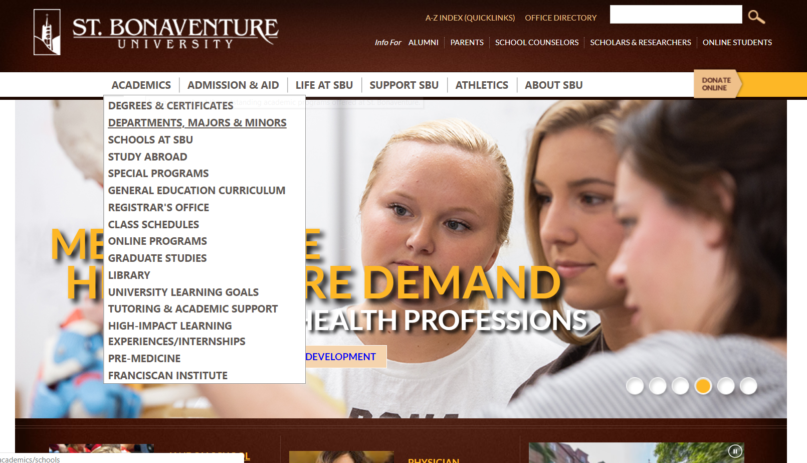

Slide 8


Slide 9
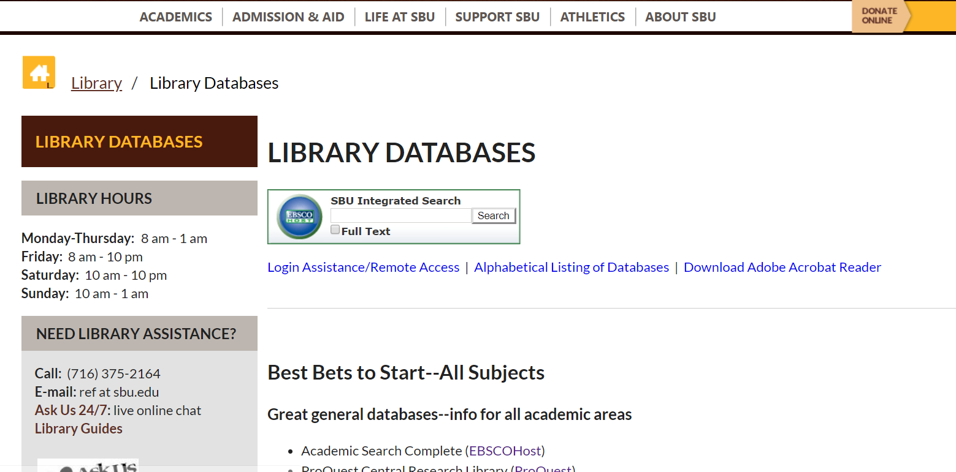

Slide 10
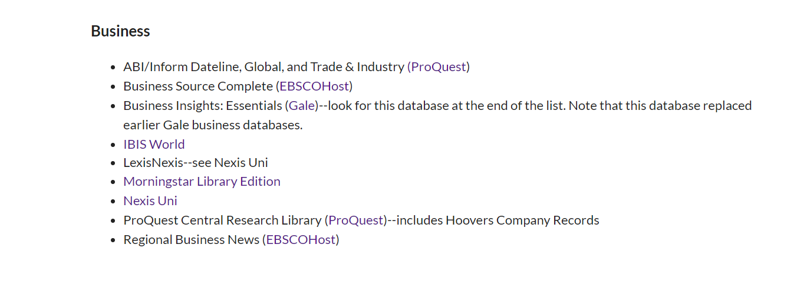

Slide 11
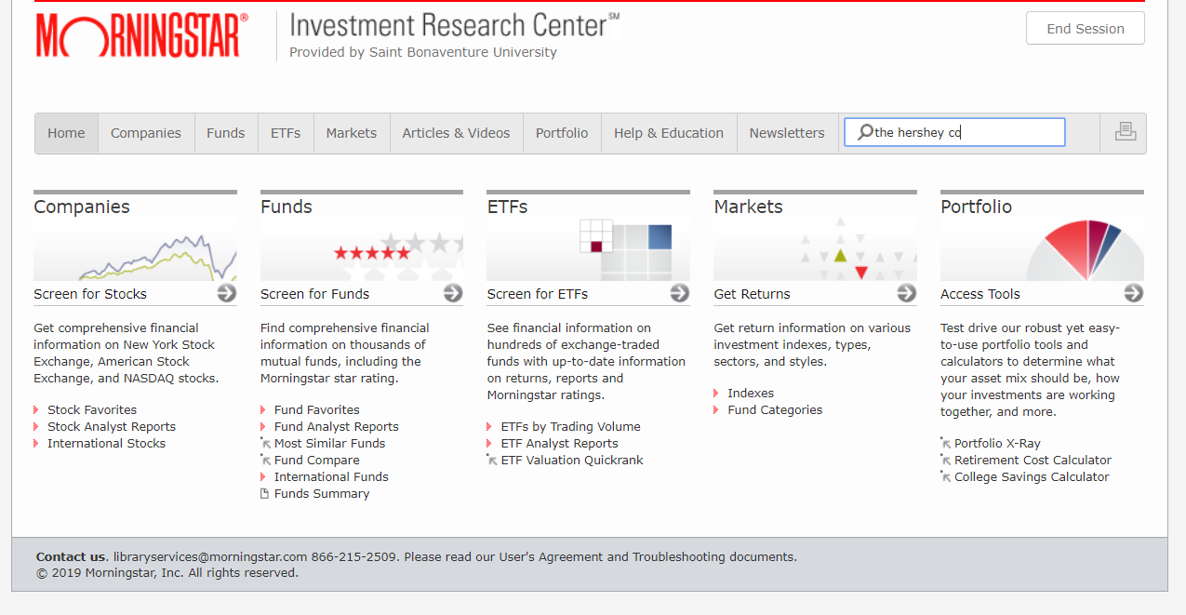

Slide 12
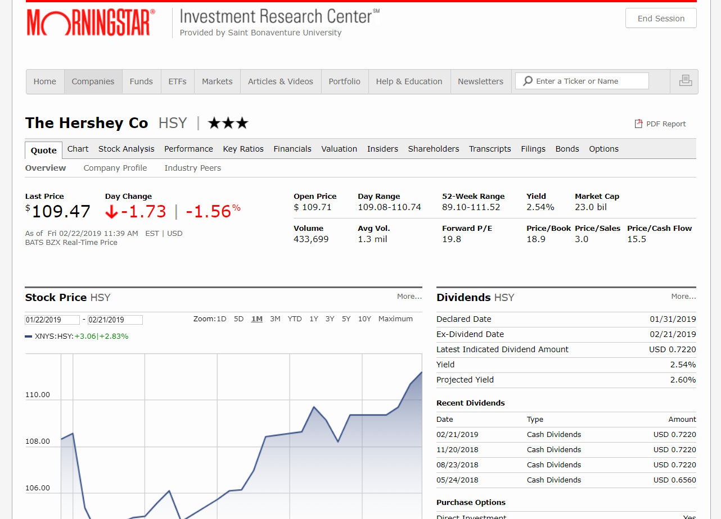
Use Morningstar to locate:
-Revenues -Market Share
-Recent Market Performance -Current Company News
-Professional Stock Analysis -Financials
-Industry Peers
-Performance

Slide 14
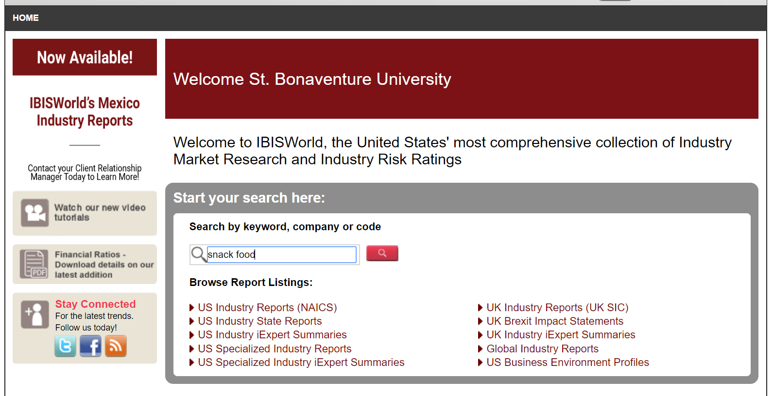

Slide 15
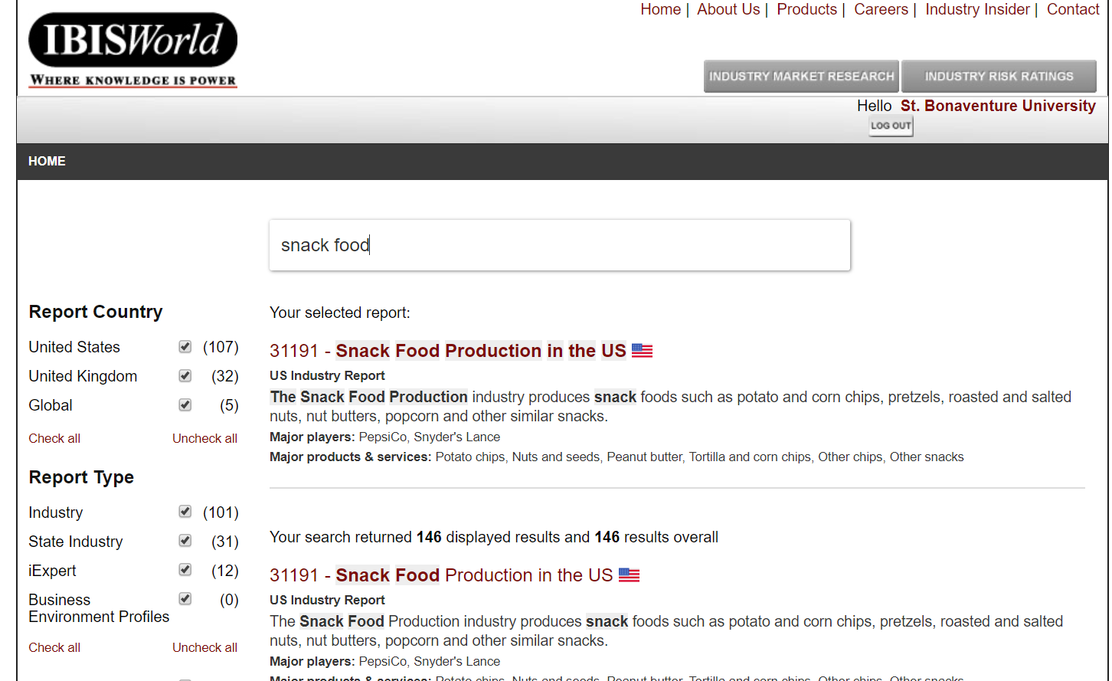

Slide 16
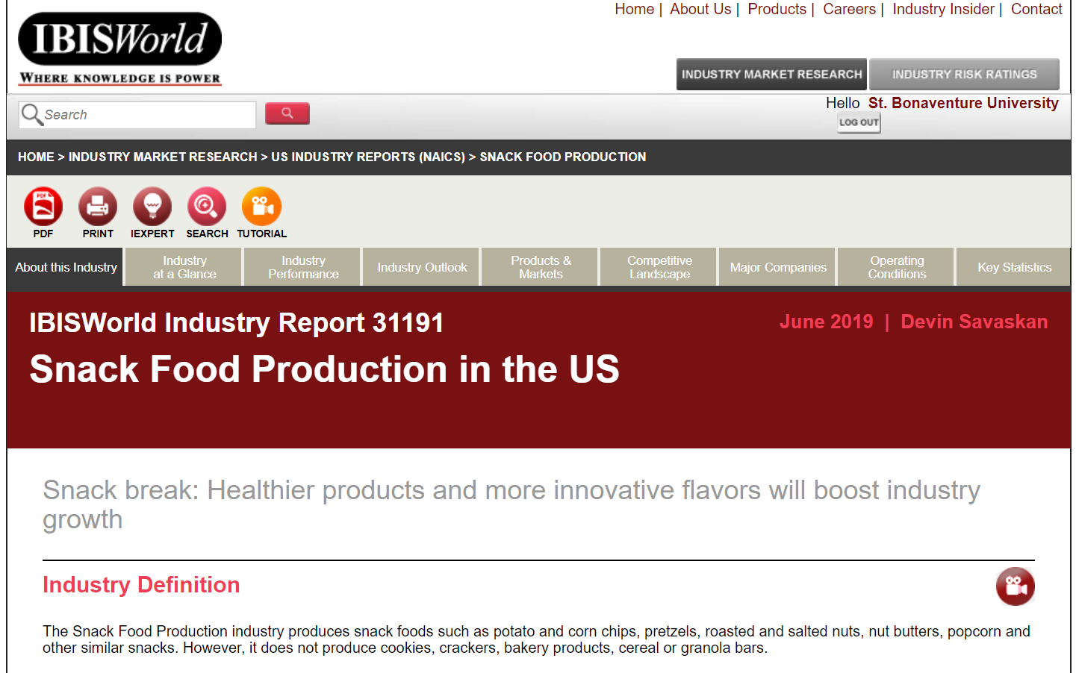
Use IBISWorld to locate:
-Industry at a Glance -Major Companies
-Performance -Key Statistics
-Industry Outlook
-Competitive Landscape

Slide 17


Slide 18
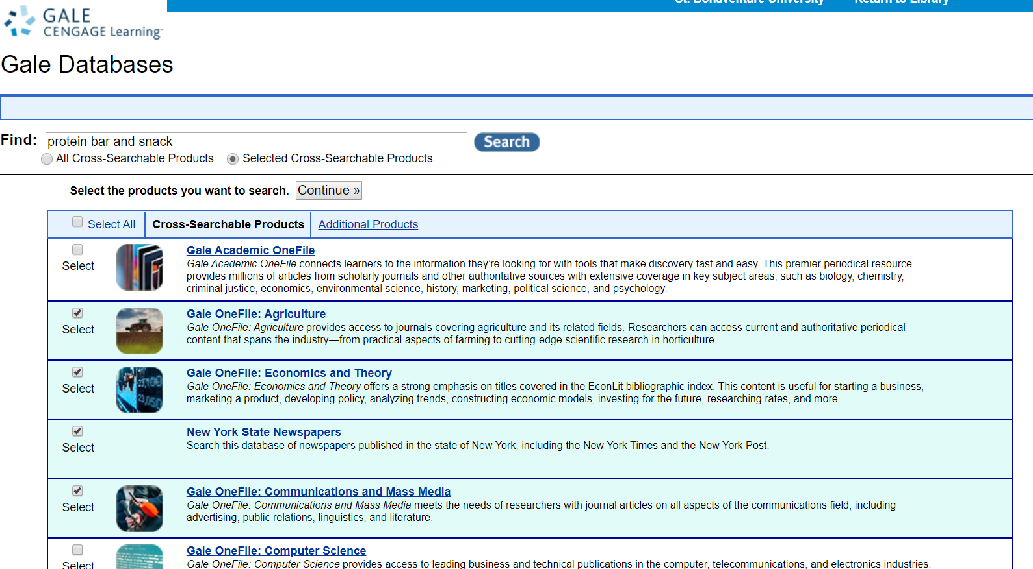

Slide 19
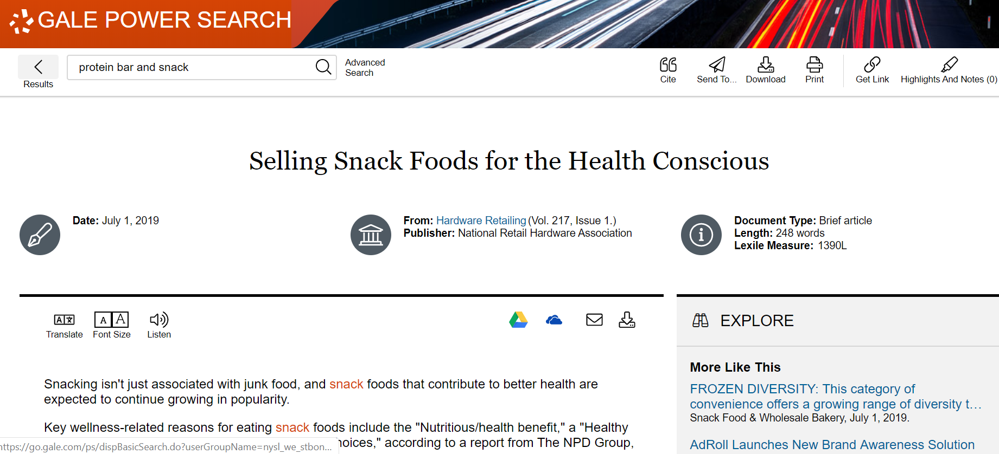

Slide 20
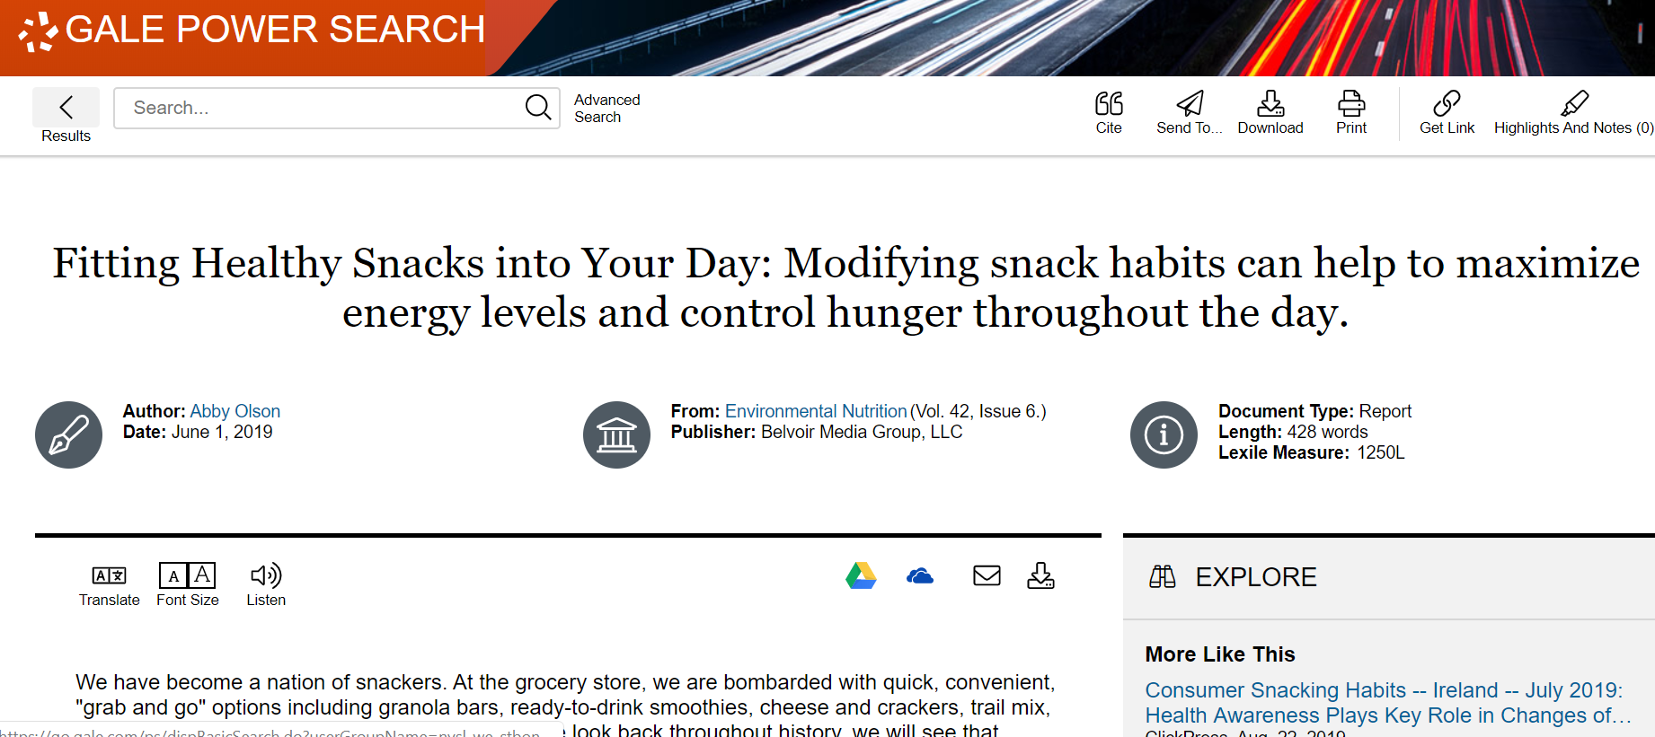

Slide 21


Slide 22
What is a trade association?
A trade association is a body representing organizations within the same trade. It aims to protect their collective interests, especially in negotiations with governments and labor unions.
Source: https://www.collinsdictionary.com/us/dictionary/english/trade-association

Slide 23
Types of information found on trade association sites
Advocacy data
Studies and reports
Statistics
Quotable spokespeople
Referrals to interview subjects
Leads to additional information

Slide 24
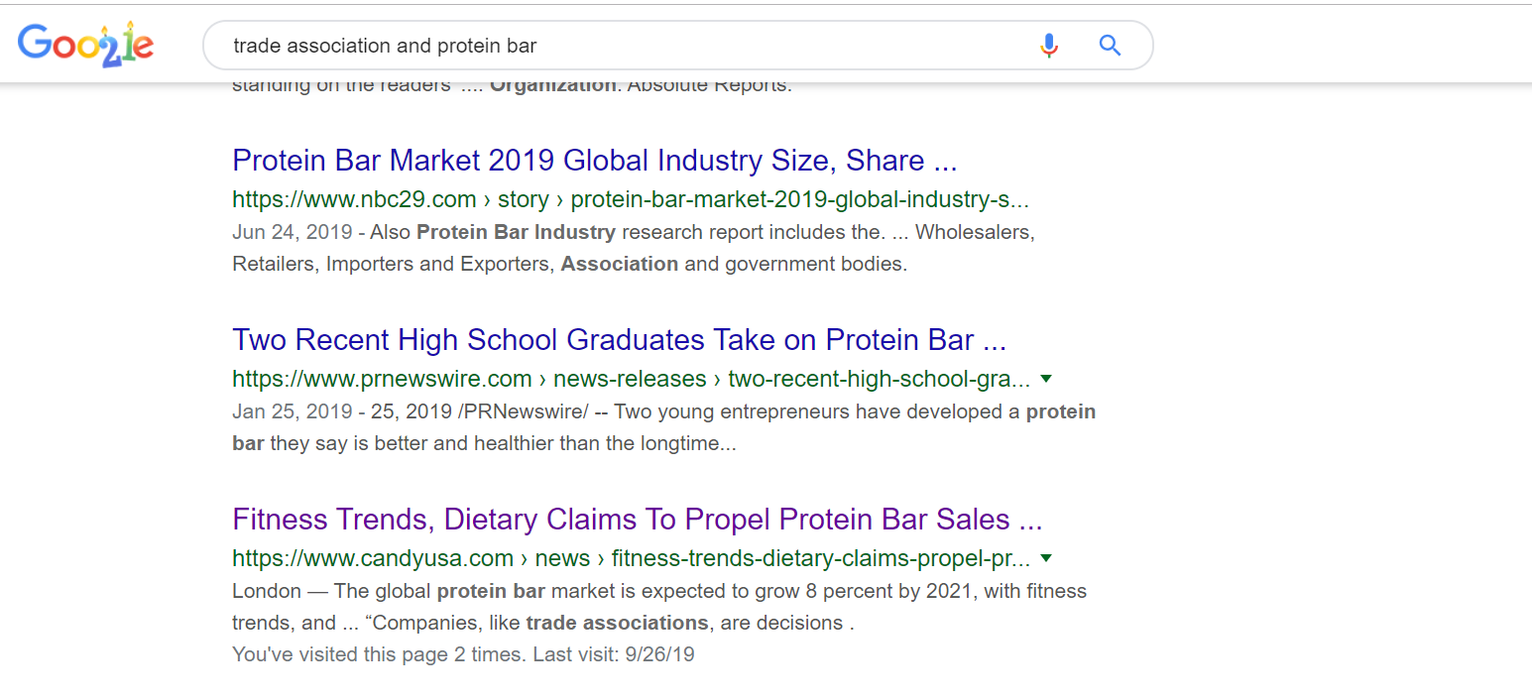

Slide 25


Slide 26


Slide 27
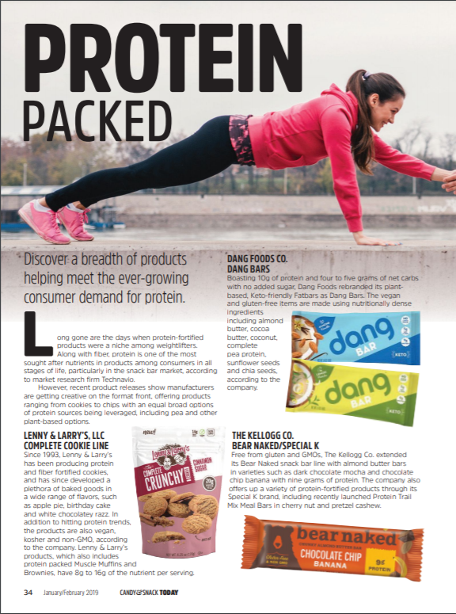

Slide 28
What is a think tank?
A think tank, policy institute, or research institute is an organization that performs research and advocacy concerning topics such as social policy, political strategy, economics, military, technology, and culture.

Slide 29

Pew Research Center is a nonpartisan think tank that informs the public about the issues, attitudes and trends shaping the world. It conducts public opinion polling, demographic research, media content analysis and other social science research. Pew Research Center does not take policy positions.

Slide 30


Slide 31
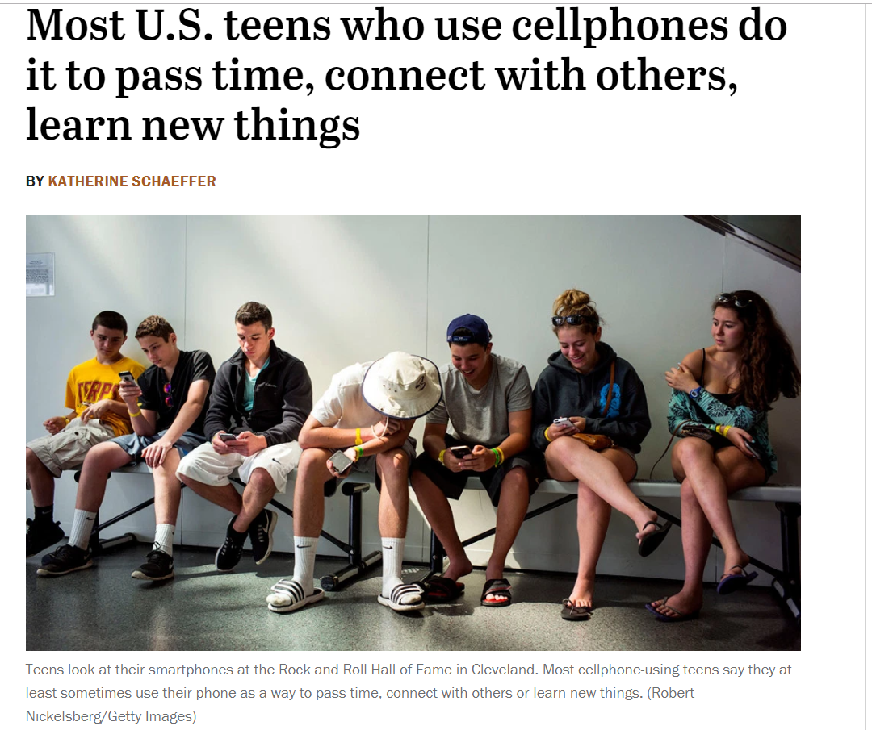

Slide 32
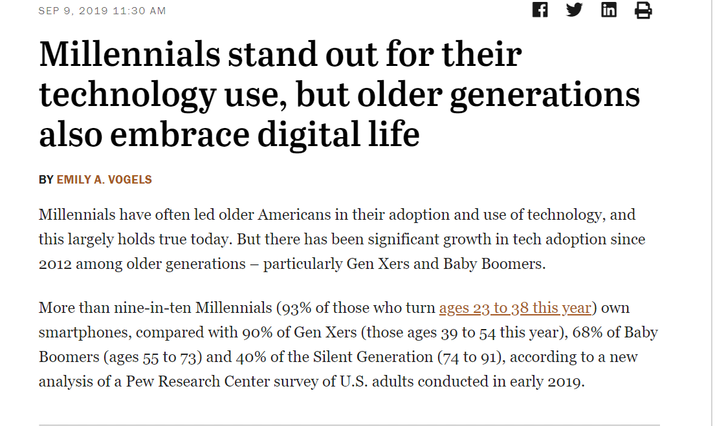

Slide 33


Slide 34
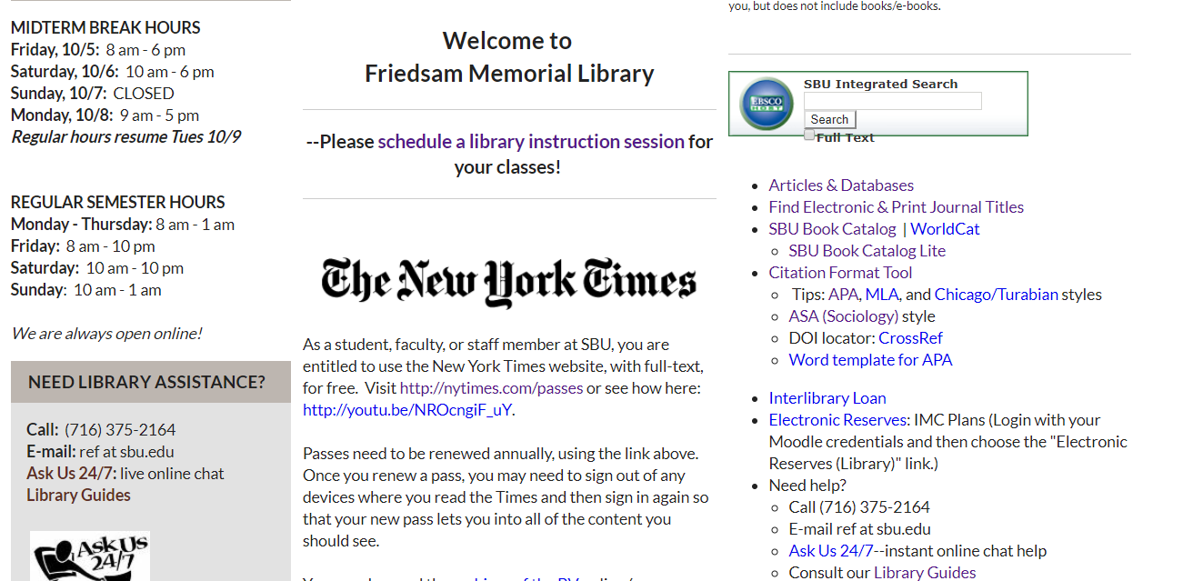
Get APA citation help with Purdue Owl

Slide 35
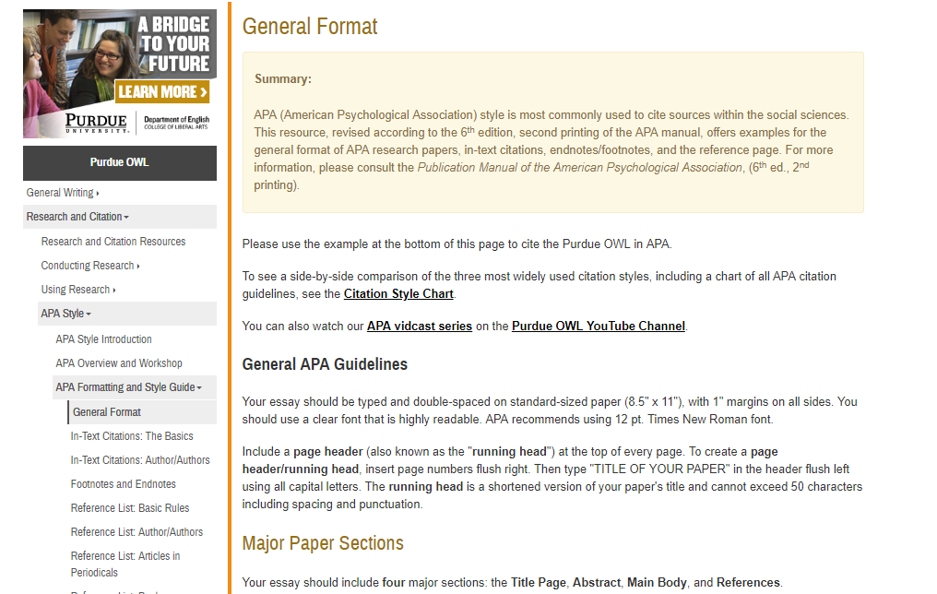

Slide 36


Slide 37
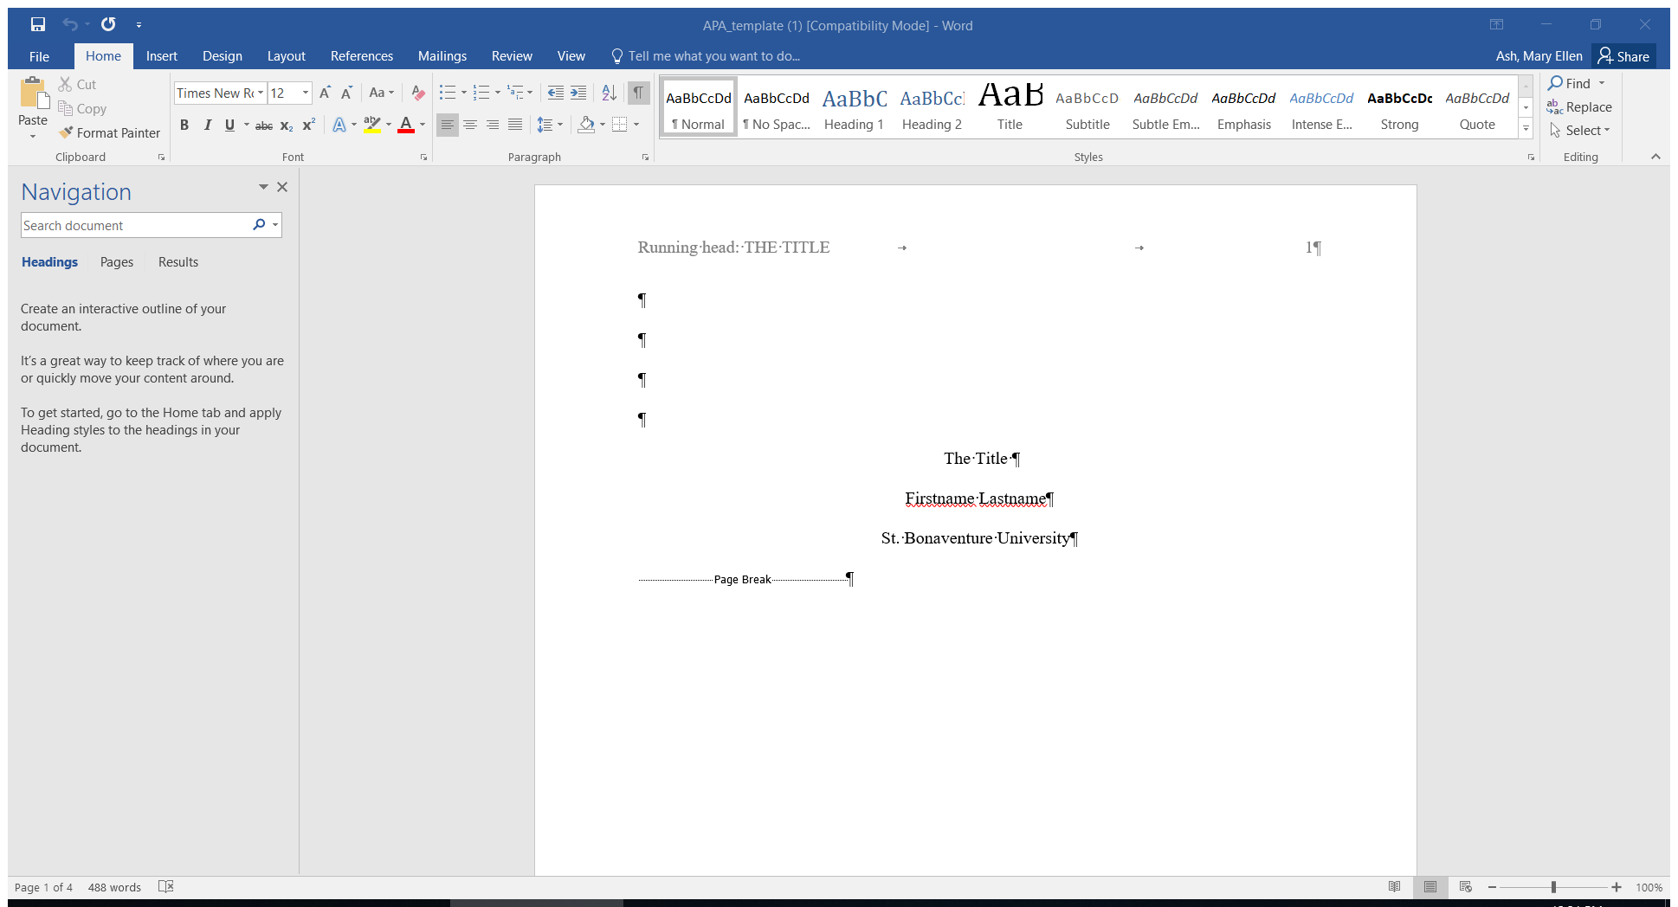

Slide 38
APA: The Basics
-Your paper should include three major sections: the Title Page, Main Body and References.
-All text on the title page, and throughout your paper, should be double-spaced.
-The preferred typeface is Times New Roman, 12 pt.

Slide 39
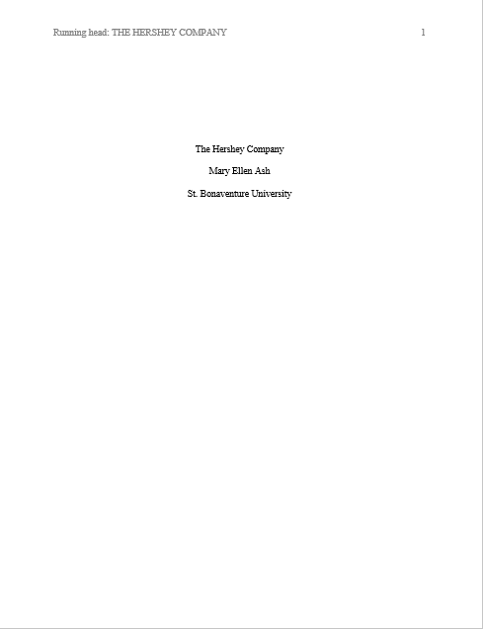
The title page should contain the title of the paper, the author's name, and the institutional affiliation. Please note that on the title page, your page header/running head should look like this--
Page number should be flush right.

Slide 40
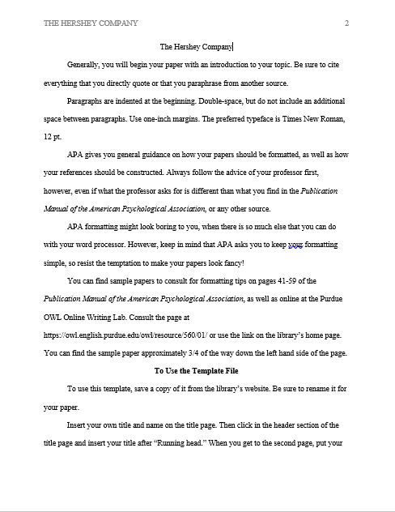
Pages after the title page should have a running head that looks like this—
Paragraphs are indented at the beginning. Double-space, but do not include an additional space between paragraphs. Use one-inch margins.

Slide 41
How to Cite
Short quotations:
According to Jones (1998), "Students often had difficulty using APA style, especially when it was their first time" (p. 199).
or
Jones (1998) found "students often had difficulty using APA style" (p. 199); what implications does this have for teachers?

Slide 42
Summary or paraphrase
According to Jones (1998), APA style is a difficult citation format for first-time learners.
or
APA style is a difficult citation format for first-time learners (Jones, 1998, p. 199).

Slide 43
Be sure to cite everything that you directly quote or that you paraphrase from another source.
APA asks you to keep your formatting simple.
You can find sample papers to consult for formatting tips online at the Purdue OWL Online Writing Lab.

Slide 44
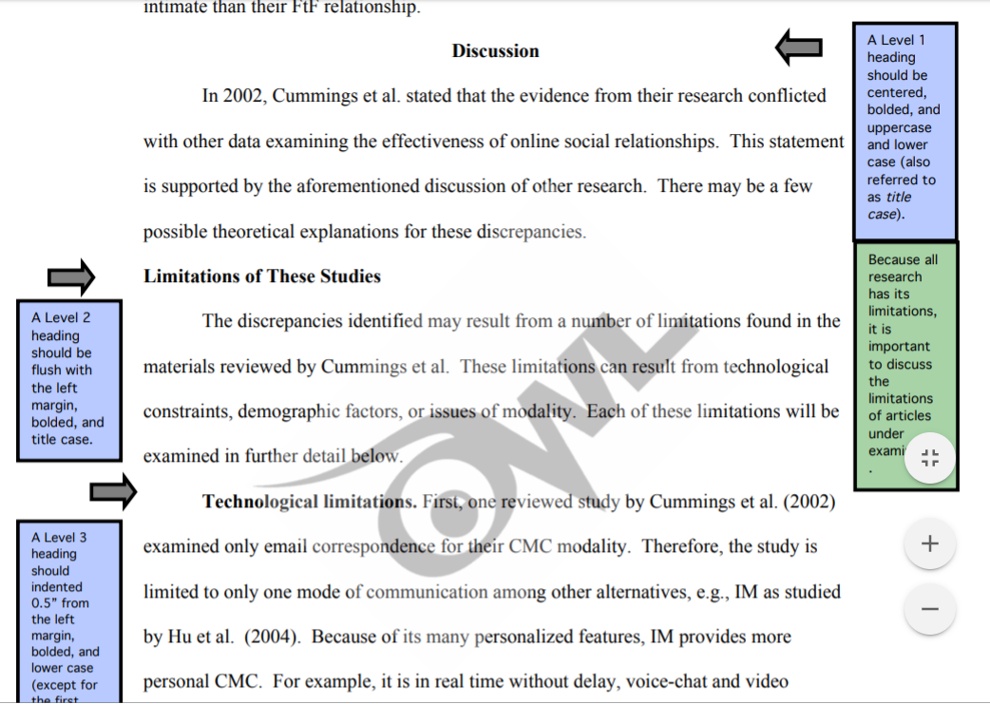
Headings
If you have distinct sections of your paper, use headings to organize your work. APA has five levels of headings, but in your papers, you generally will need no more than one, or possibly two levels.

Slide 45
Visit the Writing Lab
-Students who desire assistance with paper writing, no matter the course subject, may avail themselves of the Writing Lab.
-Students may request assistance at any stage of paper development, from formulating outlines to final draft reviews.
-An appointment is not necessary, but is recommended. Call 375-2066 to schedule an appointment.
-Please bring all materials pertaining to the assignment to your session, as well as self-edit any work you have already completed.
Location:
Student Success Center
Plassmann First Floor
Phone: 716-375-2066

Slide 46


Slide 47
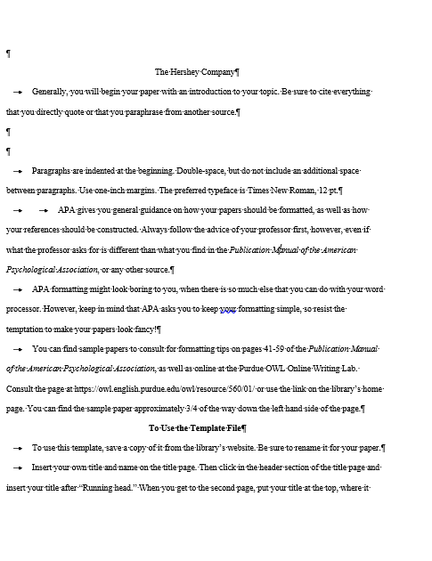

Slide 48
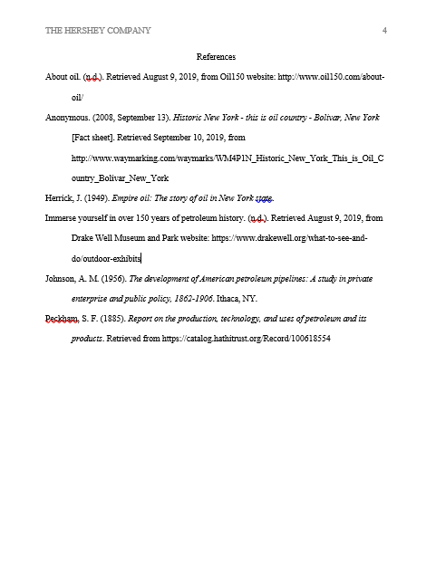
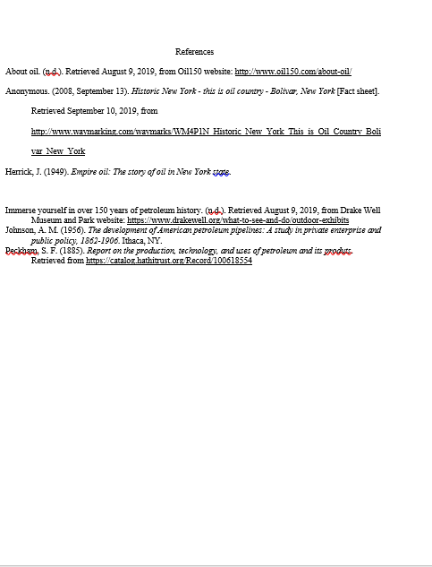

Slide 49

What is Interlibrary Loan?
Stop by the reference desk or email
ILL@sbu.edu

Slide 50
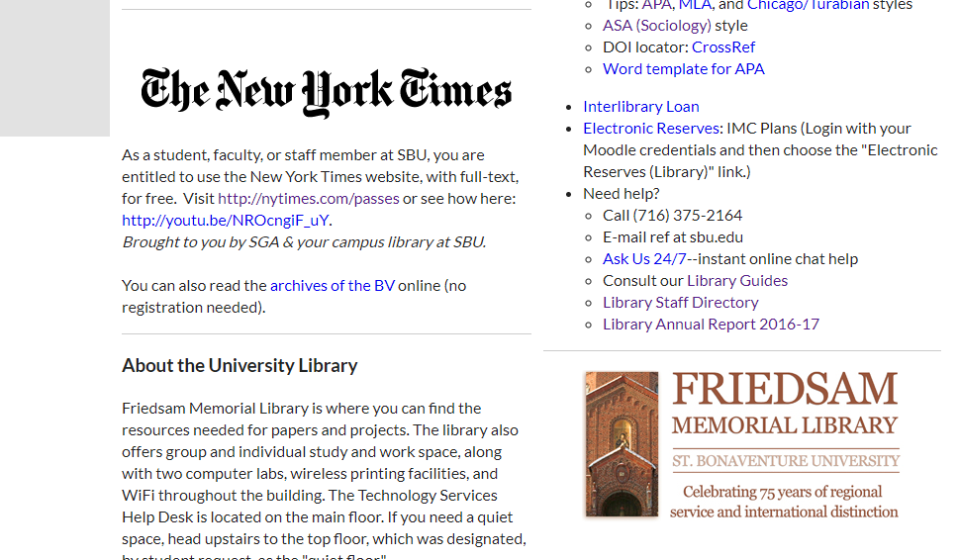

Slide 51
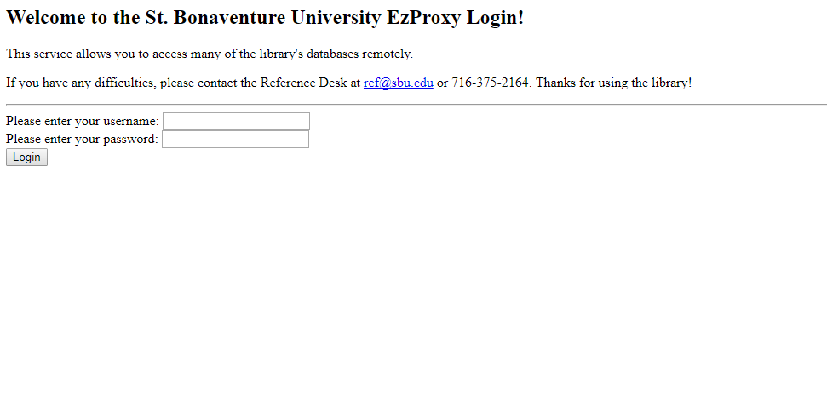
How do I log in off campus?

Slide 52
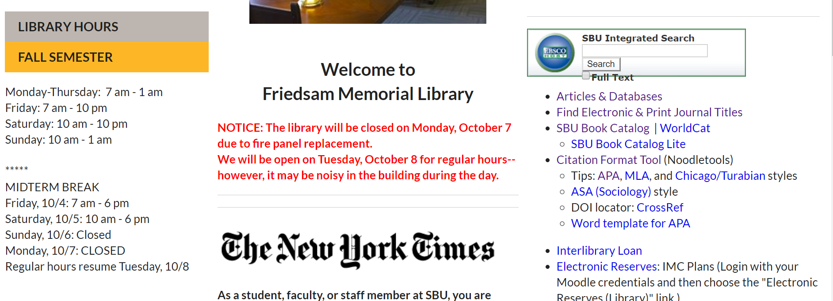

Slide 53
Need Help?
  Talk to your professor
  Email me at mash@sbu.edu
  Call, email or stop by the Reference Desk
  (716) 375-2164/ref@sbu.edu
  Ask Us 24/7 - instant online chat help

Slide 54
Words of advice . . .
Start your assignment early
Use more than one database
Dig for information
Proof read your work
Ask for help
Visit the Writing Lab

Slide 55
Questions

Slide 56
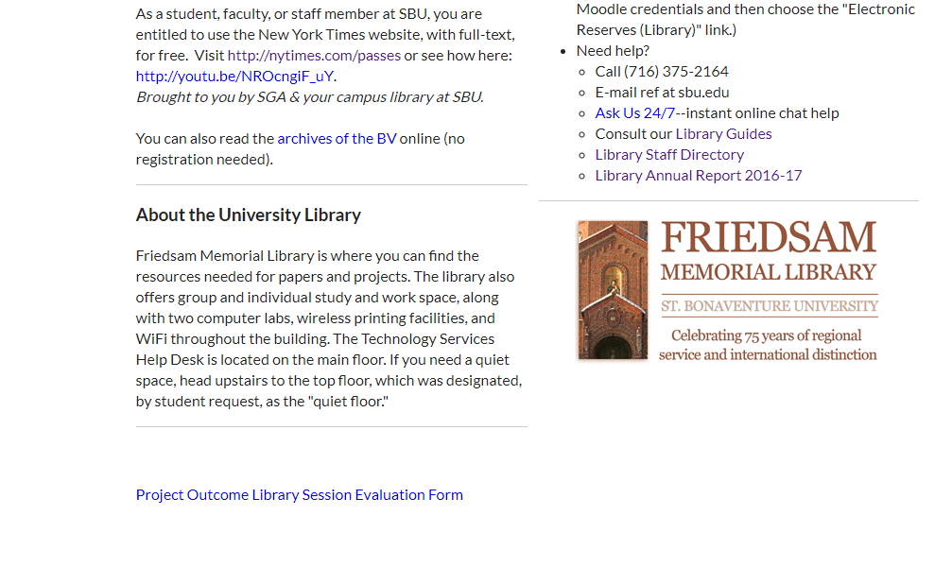
Evaluation

Slide 57
Sources
https://owl.purdue.edu/owl/research_and_citation/apa_style/apa_style_introduction.html

