Slide 1
Marketing 301
New/Emerging Innovations Project
Library Research Class
Mary Ellen Ash
Reference Librarian
February 28, 2020

Slide 2
Your Assignment
Choose a publicly held company and identify one of the company’s recent or emerging innovations;
Become an expert on the company;
Become an expert on the product innovation, including how it differs from current practices;
Who is the target market the company is trying to reach with the innovation;
Locate at least three trends/factors from three different marketing external environmental forces;
Discuss how this innovation fits into the overall strategy and mission of the company; and
Use at least 5 different outside sources with at least 3 different sources from library day. Research should be from within the last six months.

Slide 3

Choose a Public Company

Slide 4
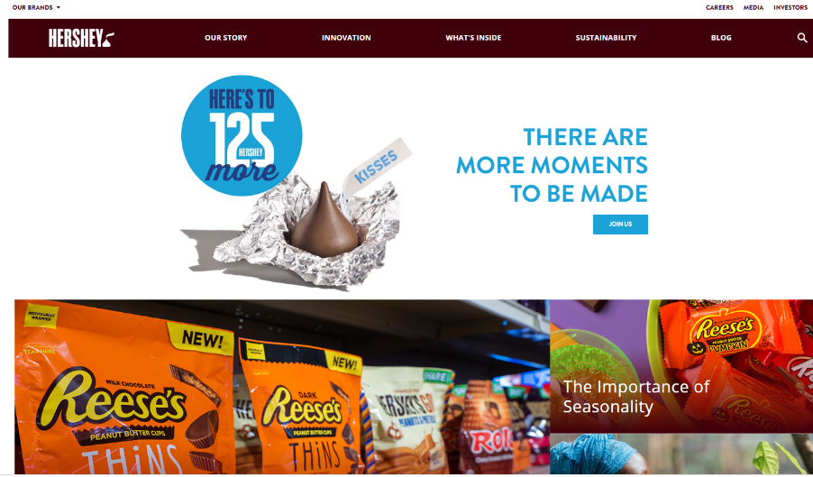
Information found on a company site:
-Company History
-Mission Statement
-List of Products/Brand
-Press Releases/News
-Corporate Social Responsibility
-Leadership
-Sustainability Reports
-Product Information
-Investor Information

Slide 5
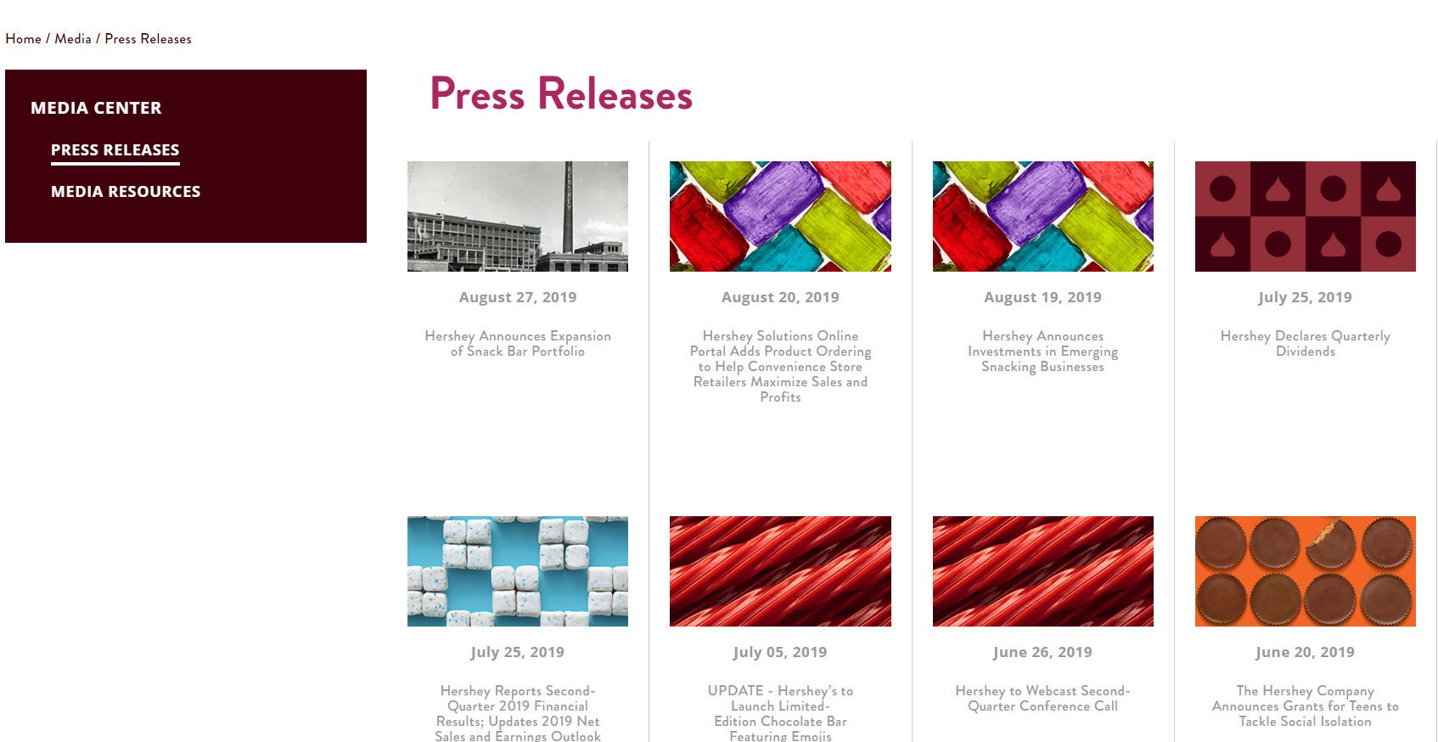

Slide 6
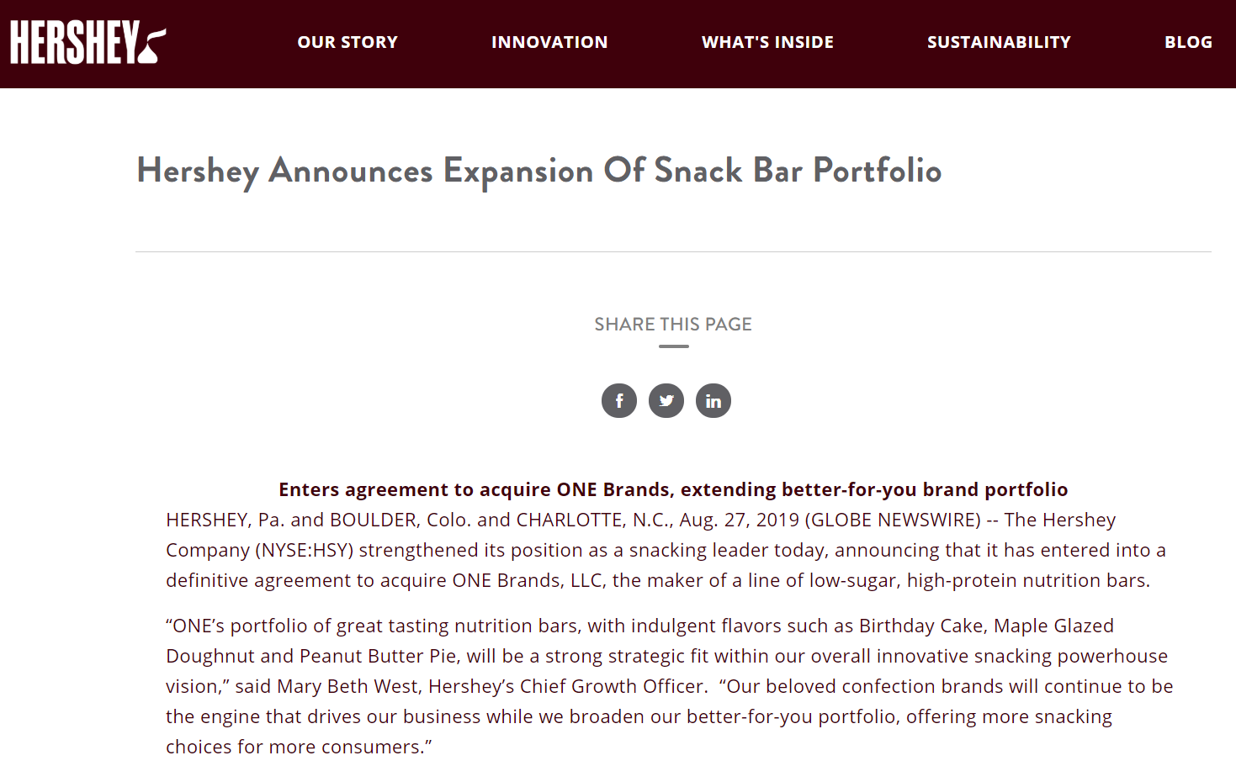
“The Hershey Company (NYSE:HSY) strengthened its position as a snacking leader today, announcing that it has entered into a definitive agreement to acquire ONE Brands, LLC, the maker of a line of low-sugar, high-protein nutrition bars. . . Our beloved confection brands will continue to be the engine that drives our business while we broaden our better-for-you portfolio, offering more snacking choices for more consumers. . . . The acquisition is expected to enable Hershey to provide a competitive offering of brands in the nutrition bar category.”

Slide 7
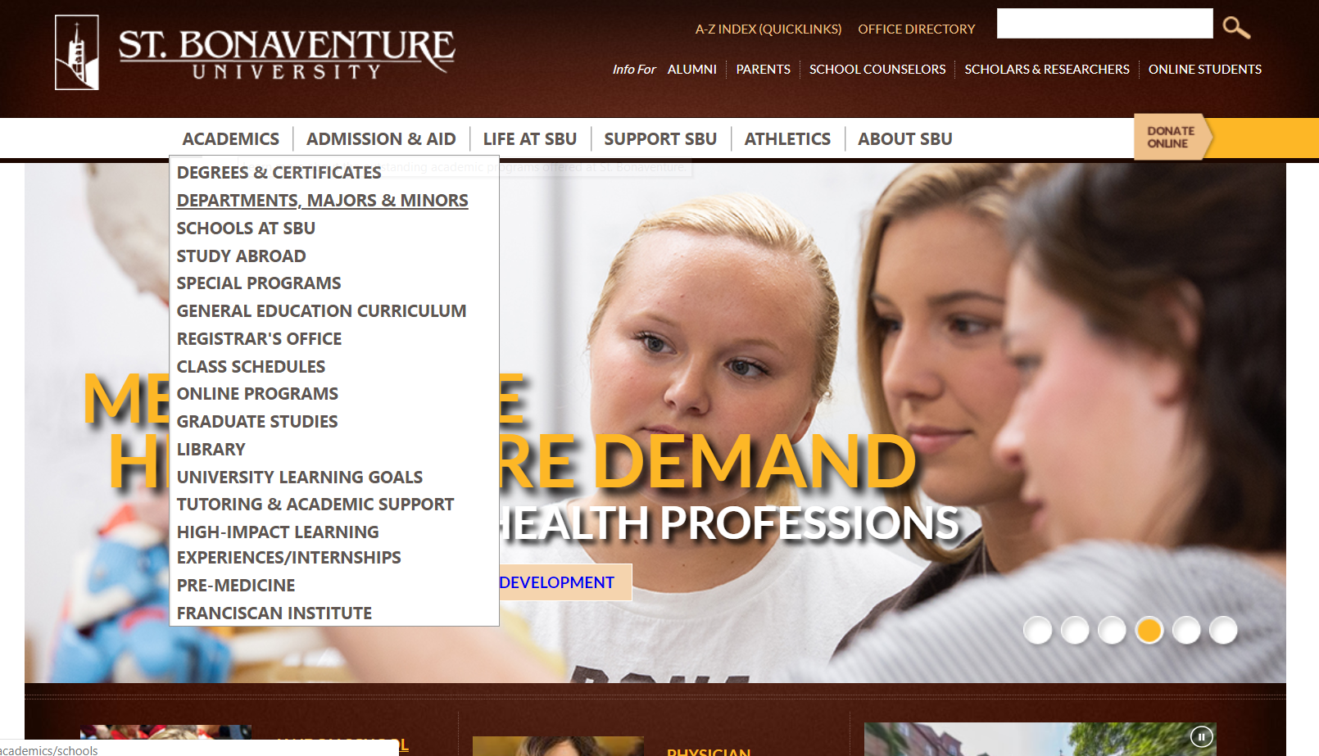

Slide 8
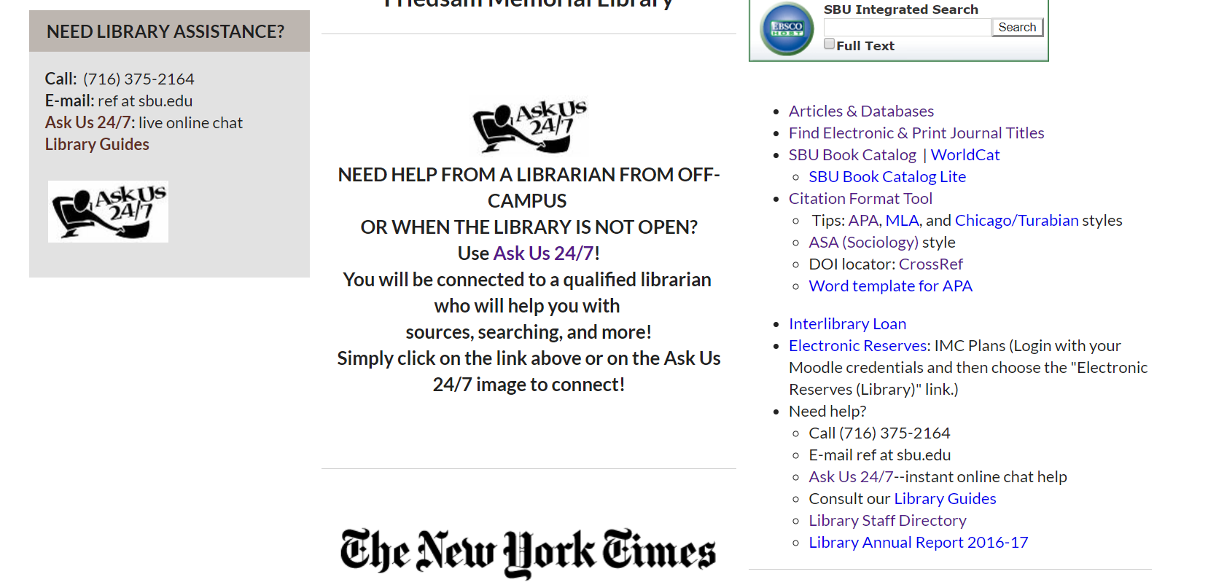

Slide 9
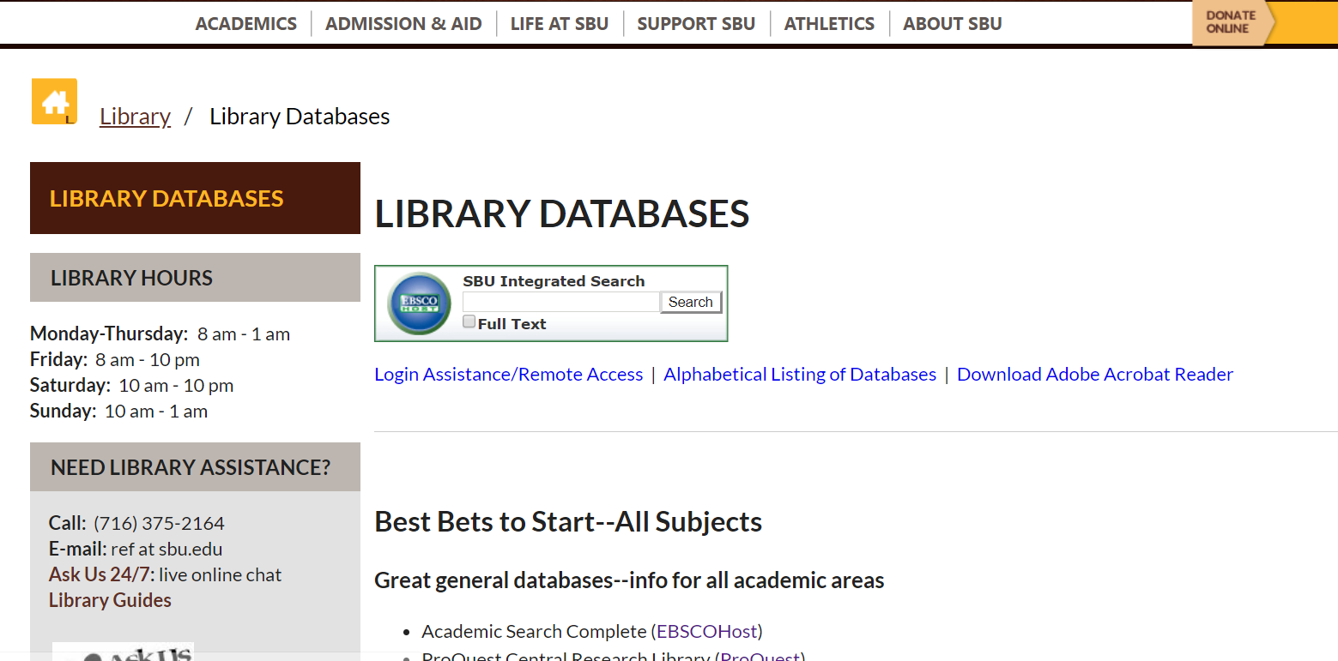

Slide 10
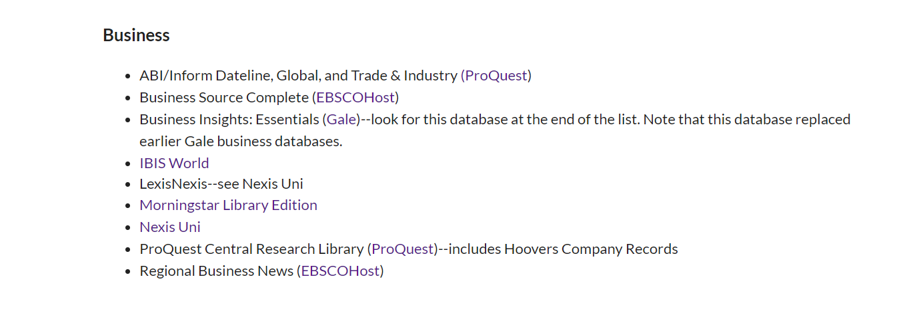

Slide 11
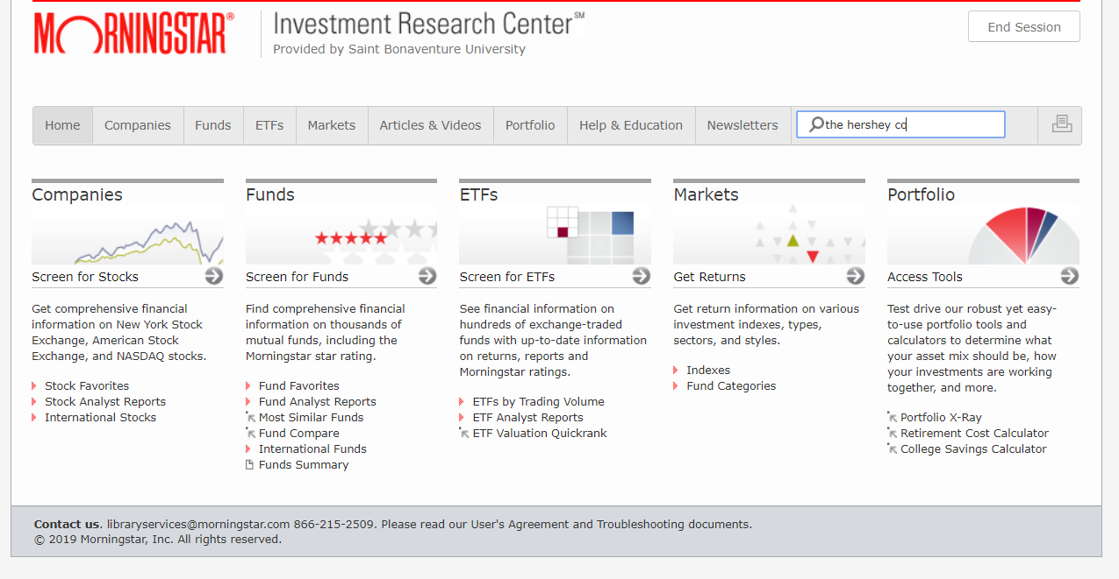

Slide 12
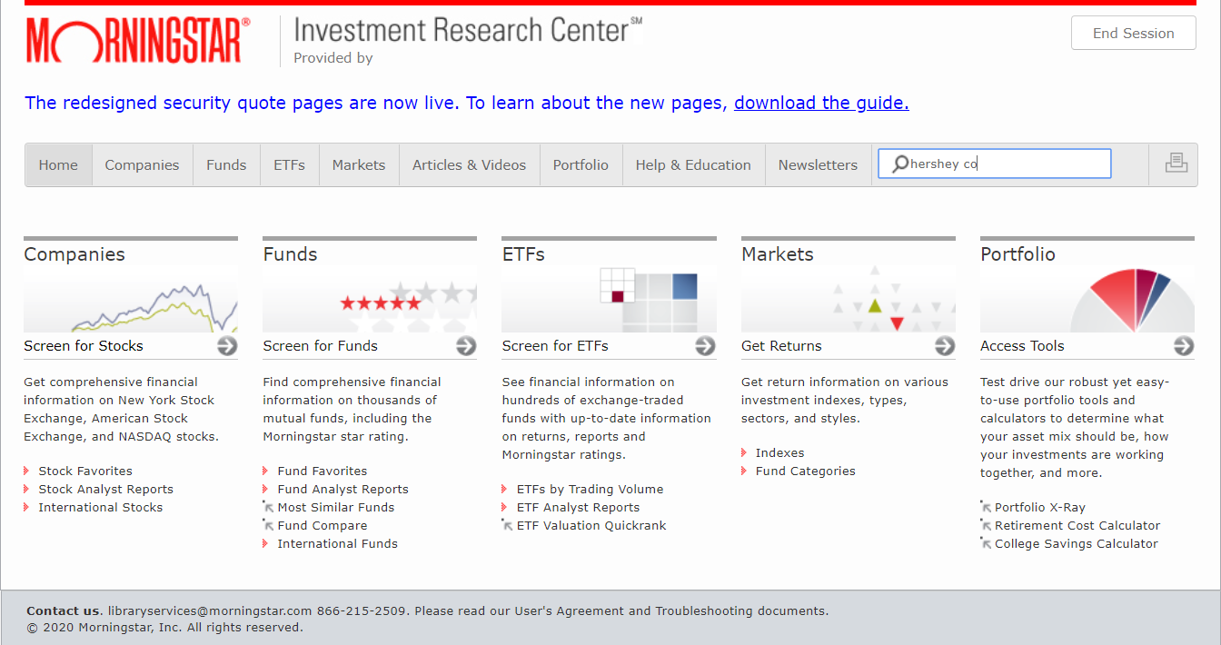
Use Morningstar to locate:
-Revenues -Market Share
-Recent Market Performance -Current Company News
-Professional Stock Analysis -Financials
-Industry Peers
-Performance

Slide 13
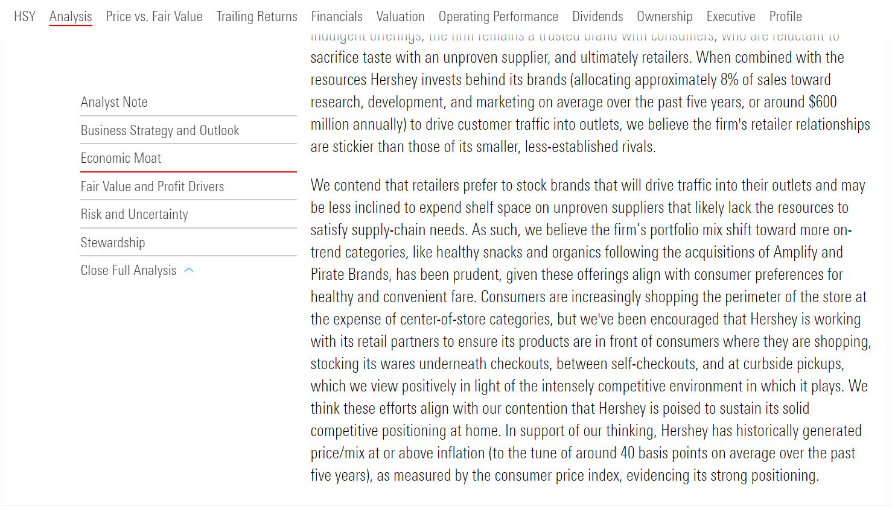

Slide 15
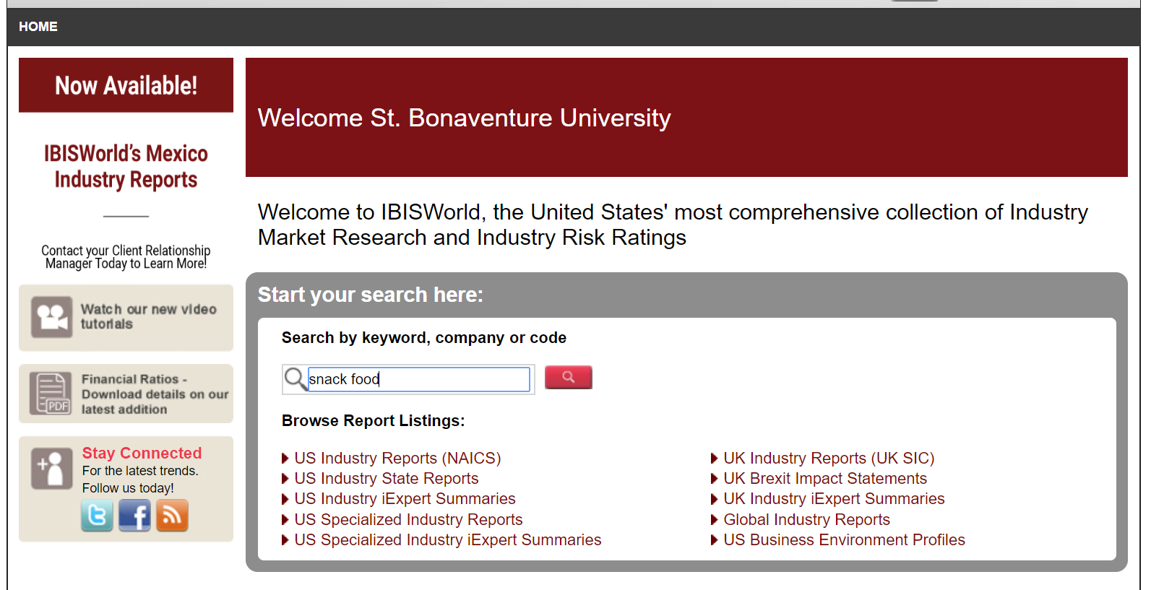
Use IBISWorld to locate:
-Industry at a Glance -Major Companies
-Performance -Key Statistics
-Industry Outlook
-Competitive Landscape

Slide 16
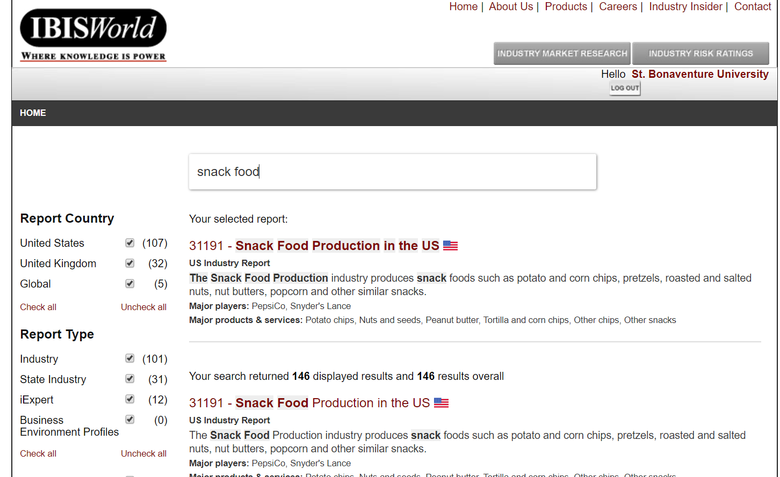

Slide 17
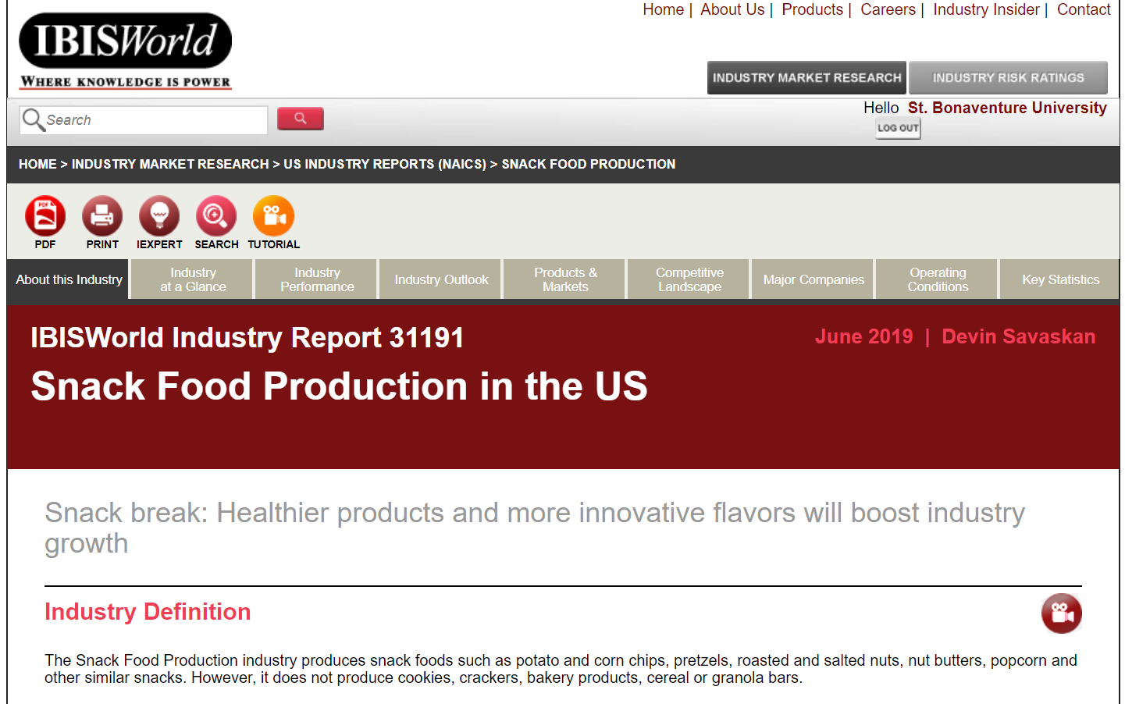

Slide 18
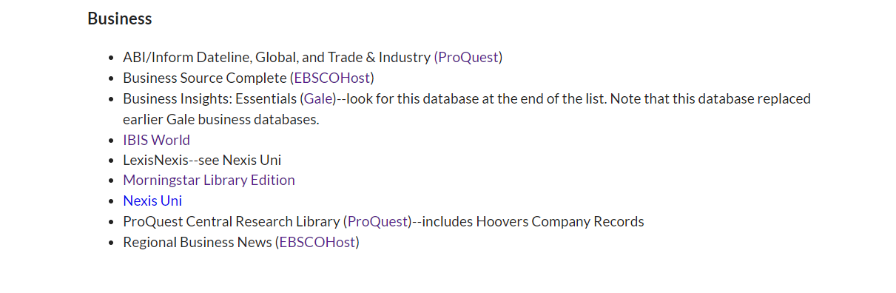

Slide 19
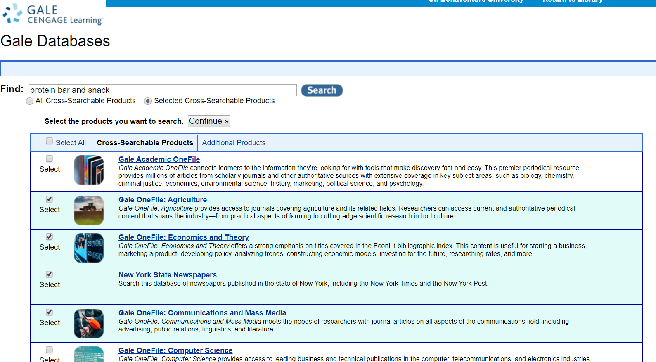

Slide 20
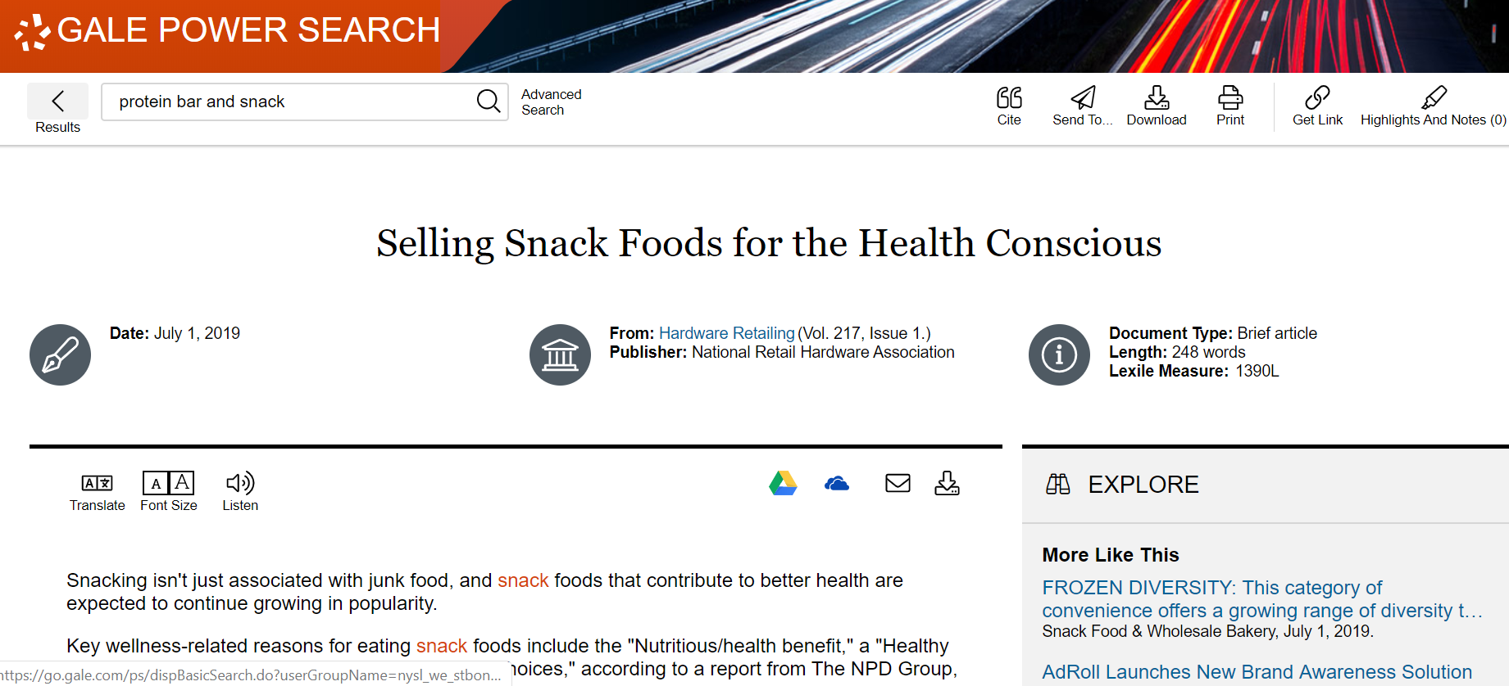

Slide 21
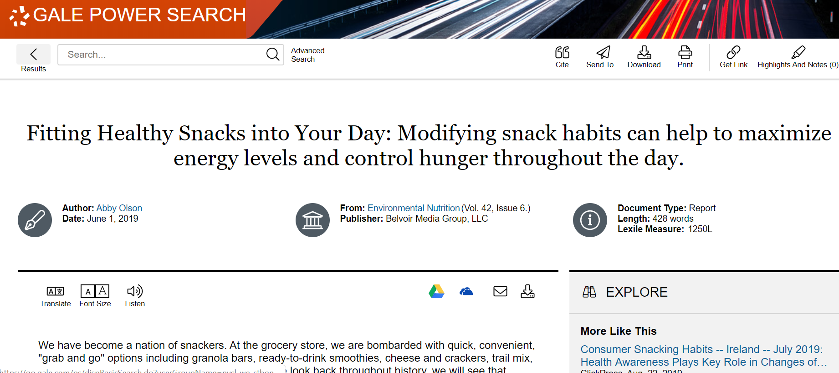

Slide 22
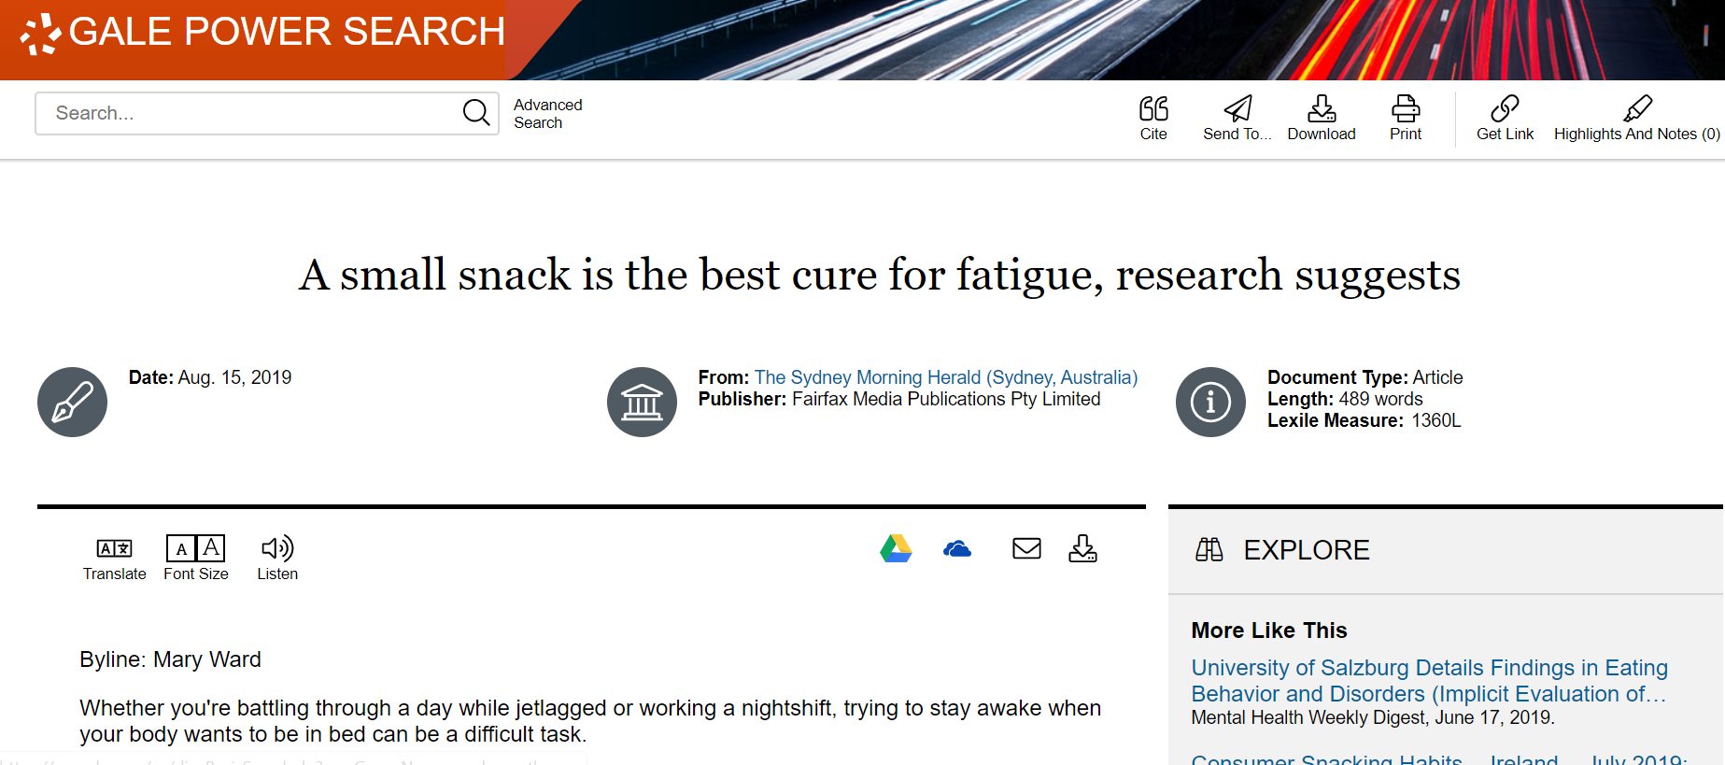

Slide 23
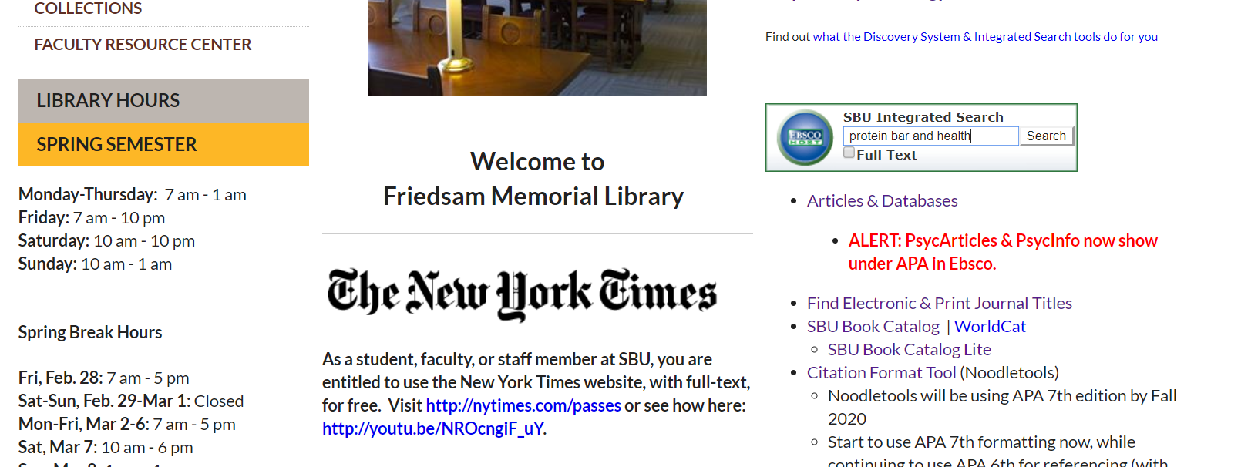

Slide 24
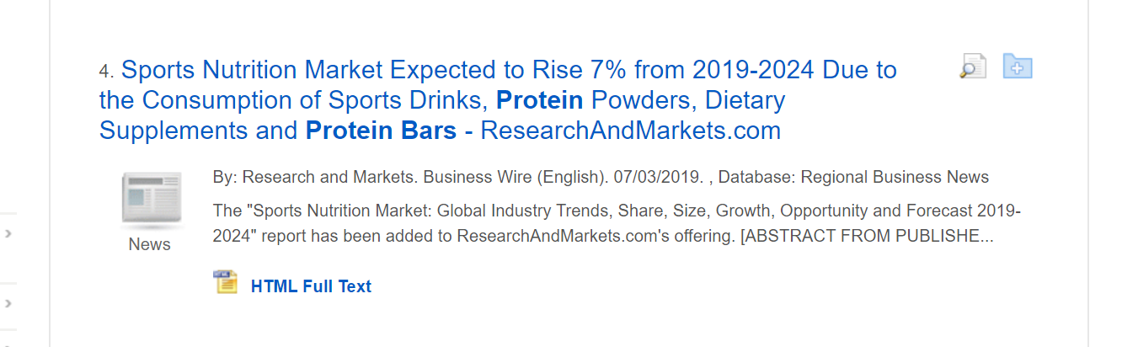

Slide 25
What is a trade association?
A trade association is a body representing organizations within the same trade. It aims to protect their collective interests, especially in negotiations with governments and labor unions.
Source: https://www.collinsdictionary.com/us/dictionary/english/trade-association

Slide 26
Types of information found on trade association sites
Advocacy data
Studies and reports
Statistics
Quotable spokespeople
Referrals to interview subjects
Leads to additional information

Slide 27
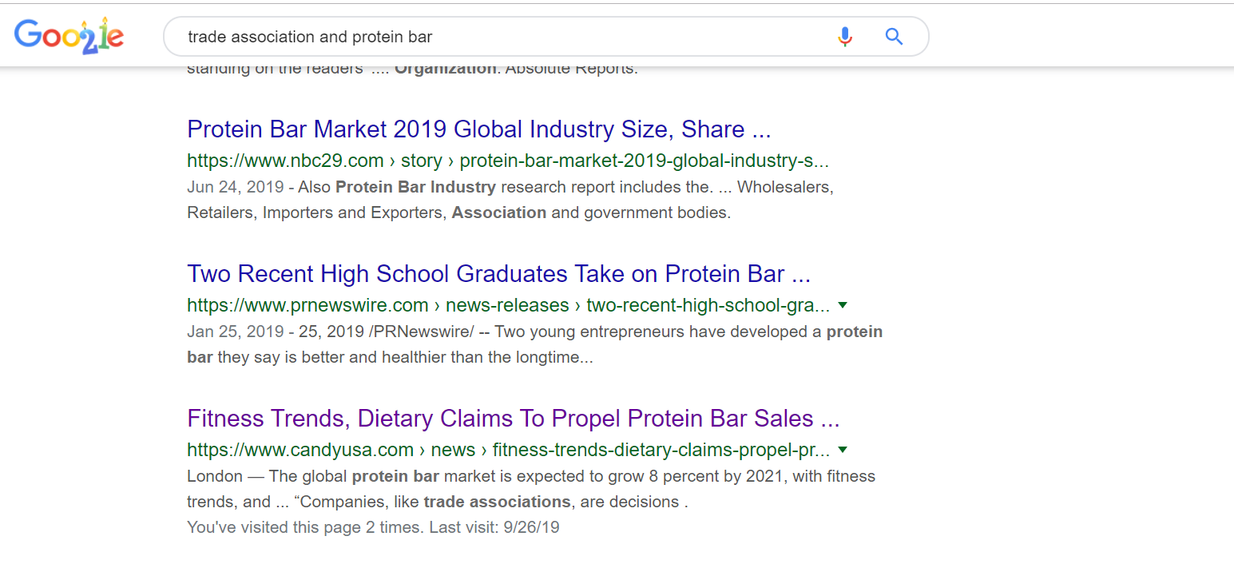

Slide 28


Slide 29
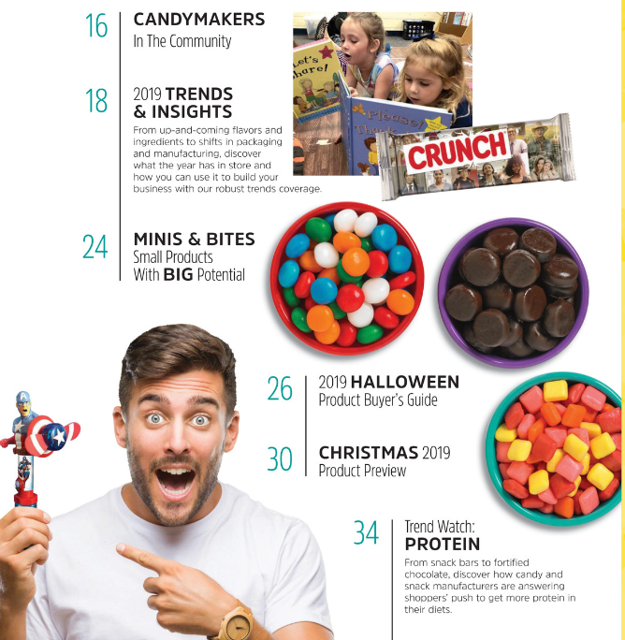

Slide 30
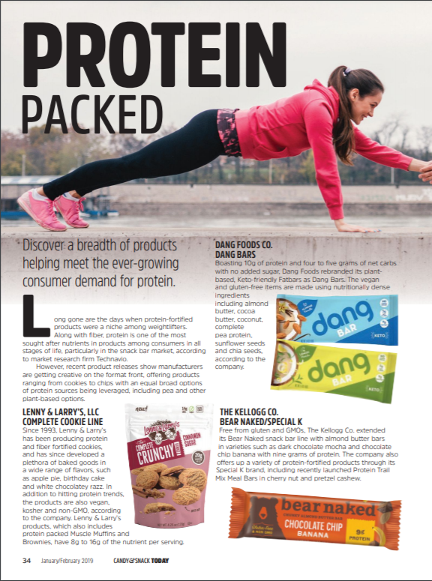

Slide 31
What is a think tank?
A think tank, policy institute, or research institute is an organization that performs research and advocacy concerning topics such as social policy, political strategy, economics, military, technology, and culture.

Slide 32
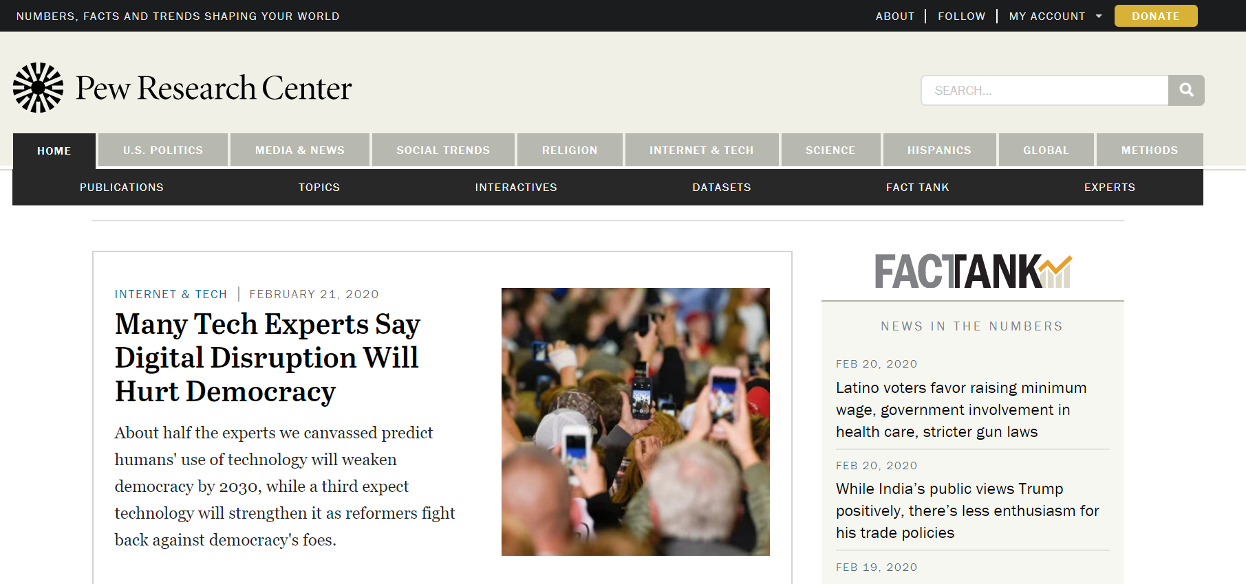
Pew Research Center is a nonpartisan think tank that informs the public about the issues, attitudes and trends shaping the world. It conducts public opinion polling, demographic research, media content analysis and other social science research. Pew Research Center does not take policy positions.

Slide 33
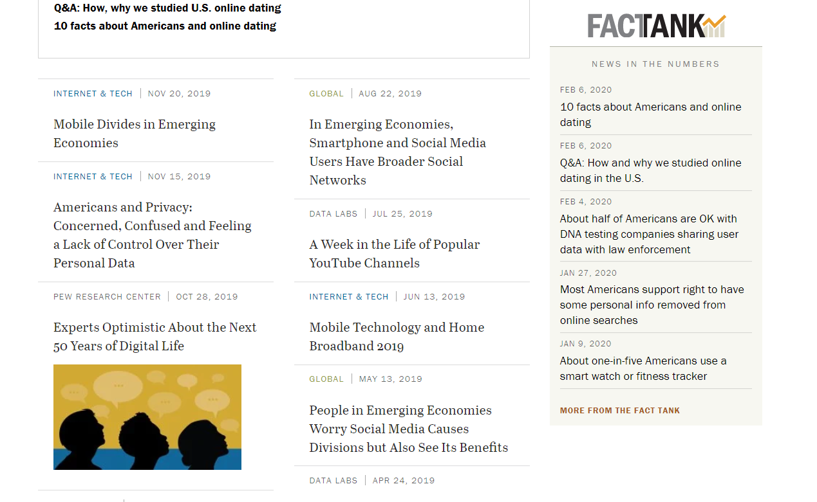

Slide 34
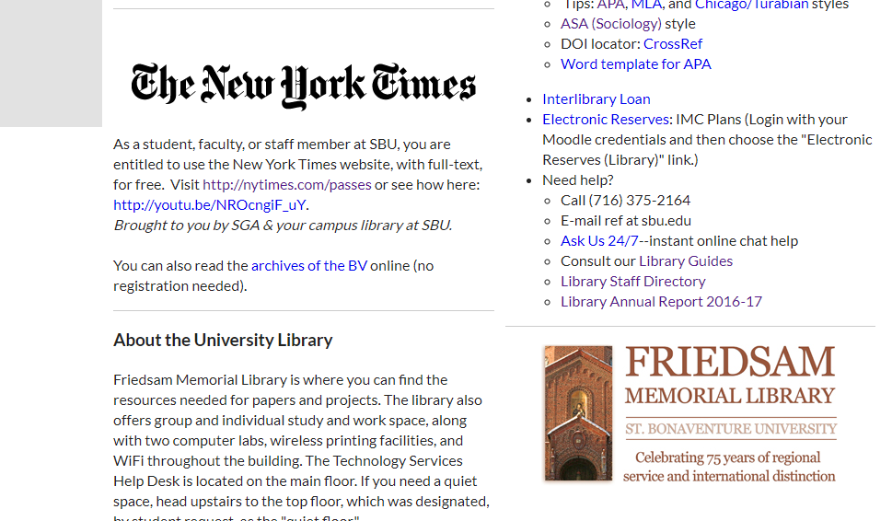

Slide 35
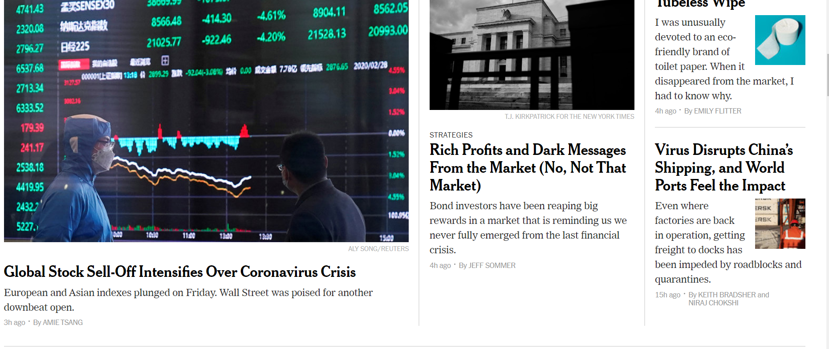

Slide 36
APA
APA just released the 7th edition of its guidelines.
You can use either the 6th or 7th edition for this assignment. You must be consistent.

Slide 37
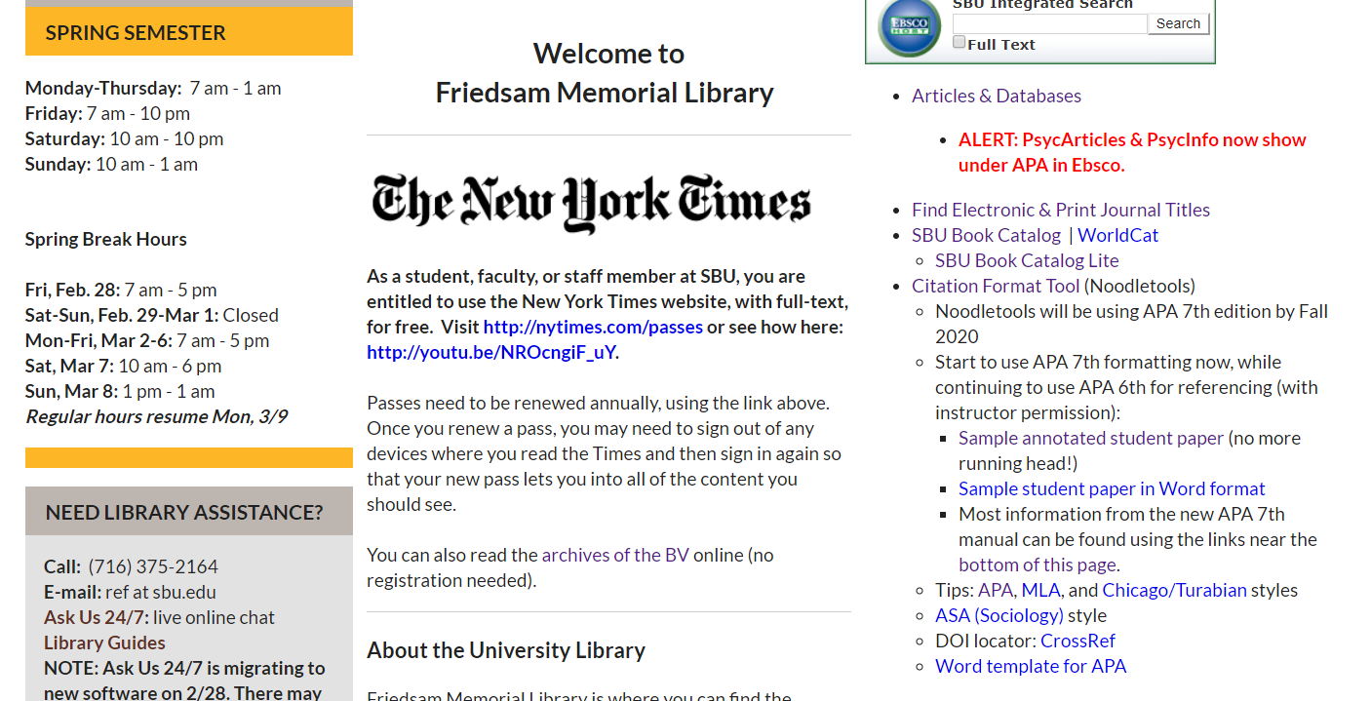
Noodletools currently supports the 6th edition of APA.
Purdue Owl is up-to-date with the 7th edition.

Slide 38
Formatting your paper
Your paper should include three major sections: title page, main body and references;
Use 1” margins throughout;
Page number on every page;
You do not need a running header if you use the 7th edition;
Double space on all pages; and
Acceptable fonts are: 11-point Calibri, 11-point Arial,10-point Lucida Sans Unicode, 12-point Times New Roman or 11-point Georgia.

Slide 39
APA Advice
Be sure to cite everything that you directly quote or that you paraphrase from another source.
APA asks you to keep your formatting simple.
You can find sample papers to consult for formatting tips online at the Purdue OWL Online Writing Lab.

Slide 40
Visit the Writing Lab
-Students who desire assistance with paper writing, no matter the course subject, may avail themselves of the Writing Lab.
-Students may request assistance at any stage of paper development, from formulating outlines to final draft reviews.
-An appointment is not necessary, but is recommended. Call 375-2066 to schedule an appointment.
-Please bring all materials pertaining to the assignment to your session, as well as self-edit any work you have already completed.
Location:
Student Success Center
Plassmann First Floor
Phone: 716-375-2066

Slide 41

What is Interlibrary Loan?
Stop by the reference desk or email
ILL@sbu.edu

Slide 42
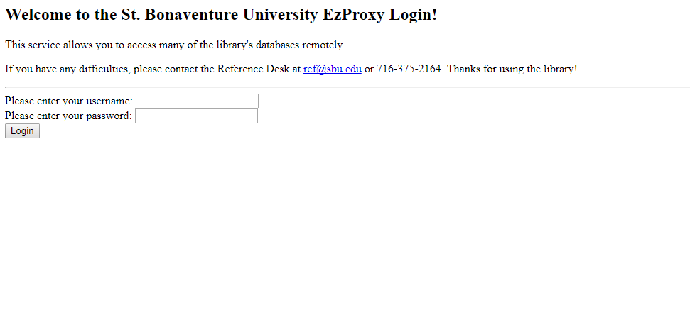
How do I log in off campus?

Slide 43
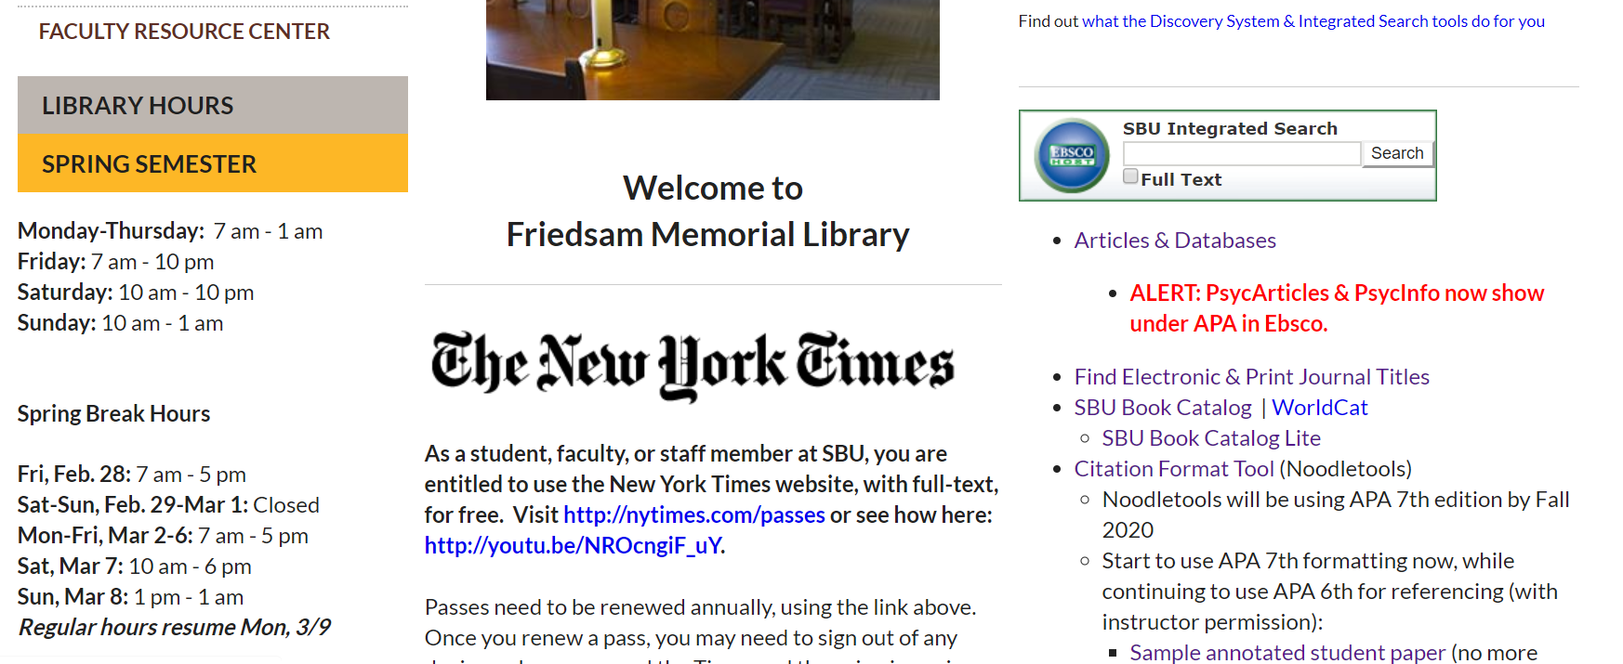

Slide 44
Need Help?
  Talk to your professor
  Email me at mash@sbu.edu
  Call, email or stop by the Reference Desk
  (716) 375-2164/ref@sbu.edu
  Ask Us 24/7 - instant online chat help

Slide 45
Words of advice . . .
Start your assignment early
Dig for information
Proofread your work
Ask for help
Visit the Writing Lab

Slide 46
Questions

